Slide 1


Larana Company
IFATCA COMMS

Slide 2
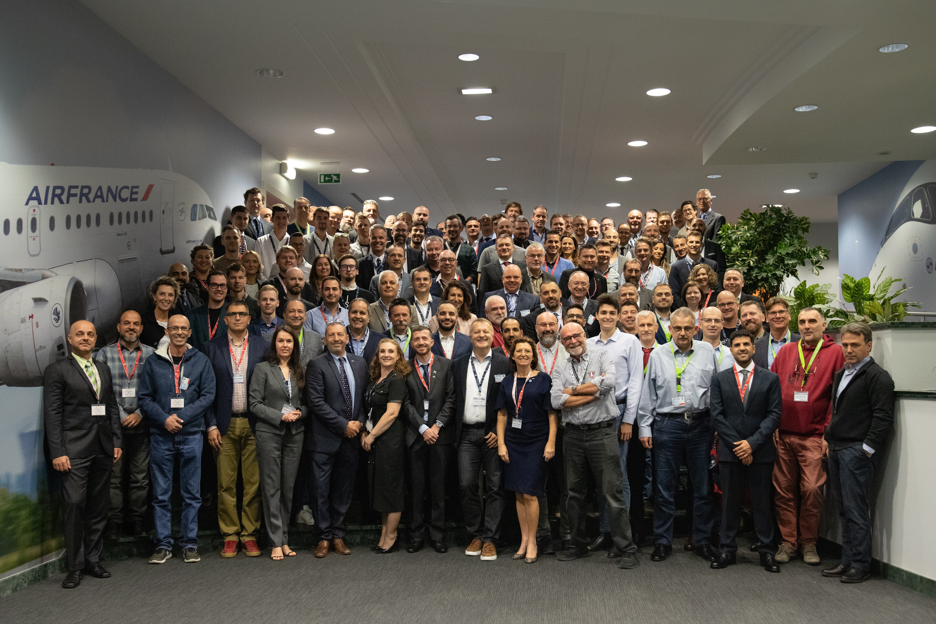


Content
  World Comms Intro
  Comms Team Members
  Comms Europe
  What we do
  Contact

Slide 3


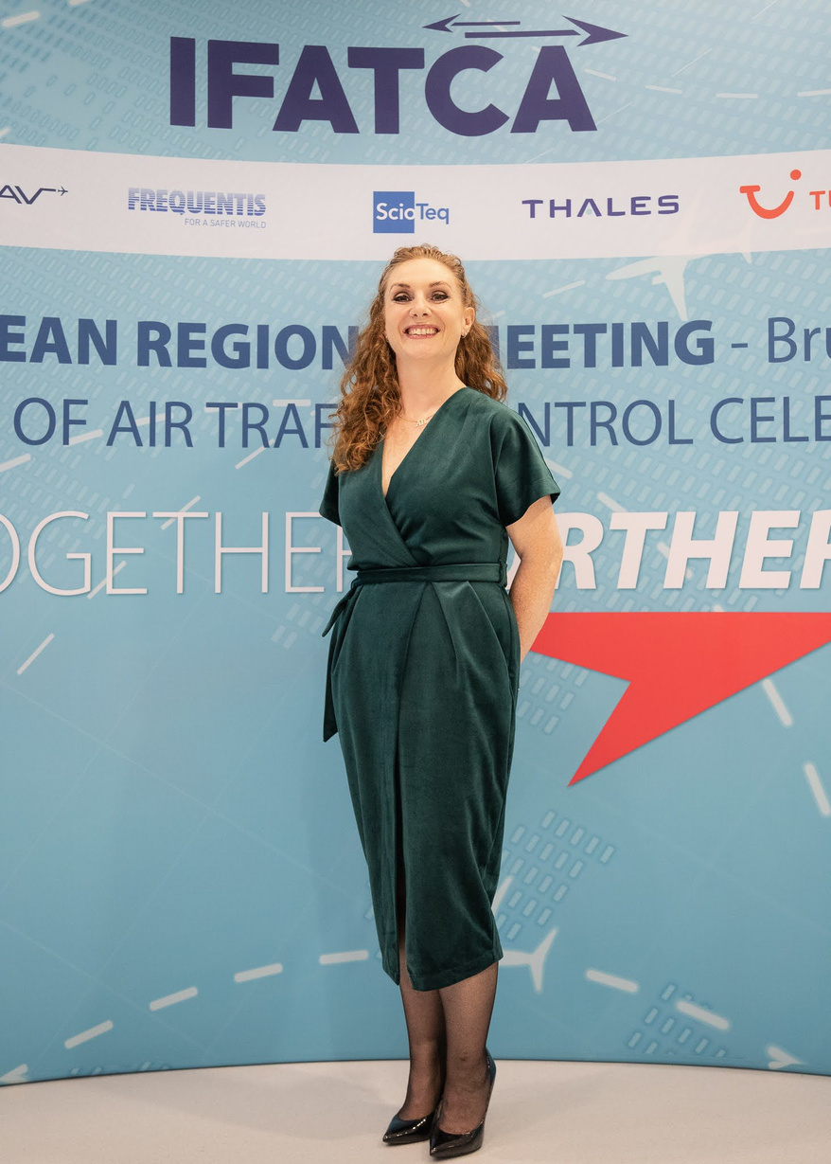

World Comms
  EUROPE
  WORLD COMMS
  ASIA-PACIFIC
  AMERICAS
  THE CONTROLLER
  AFRICA-MIDDLE EAST

Slide 4
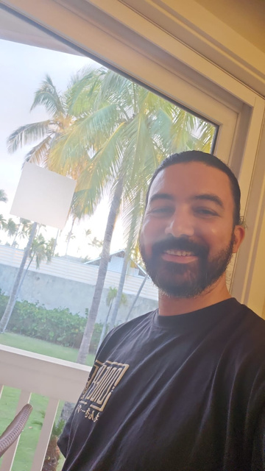
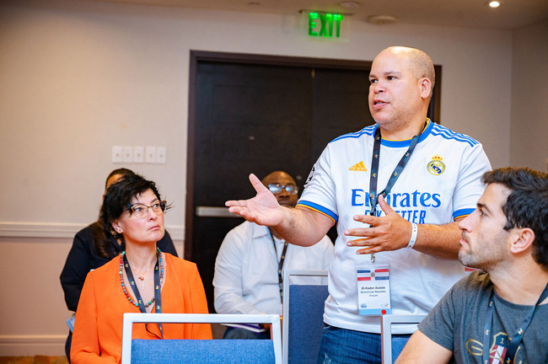
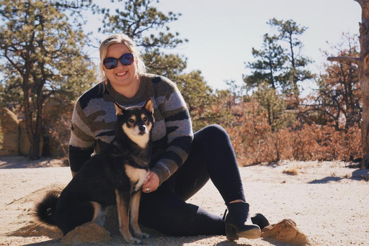
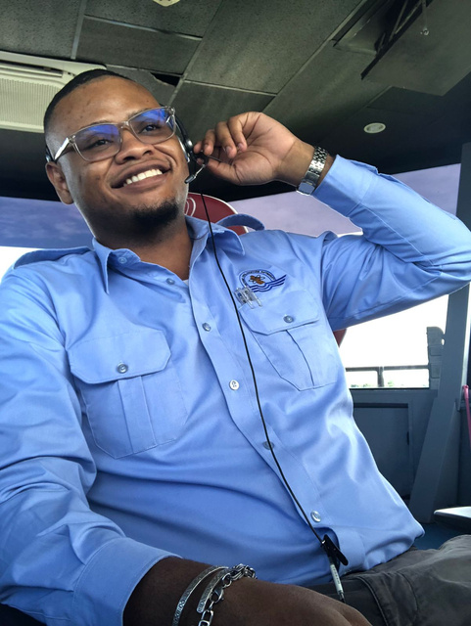
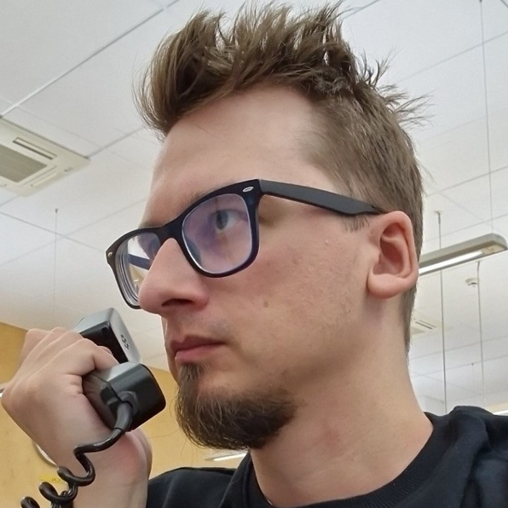

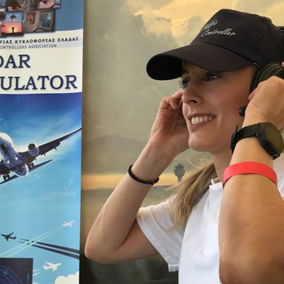
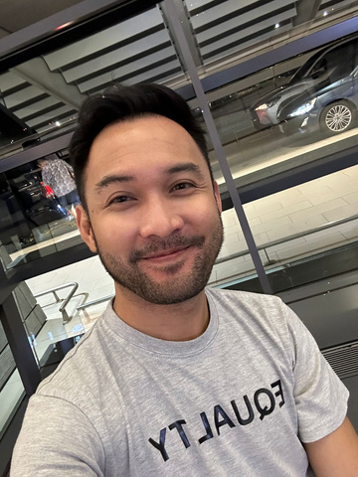
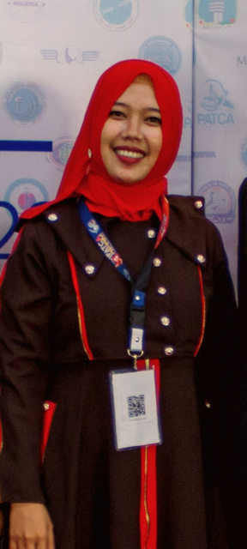
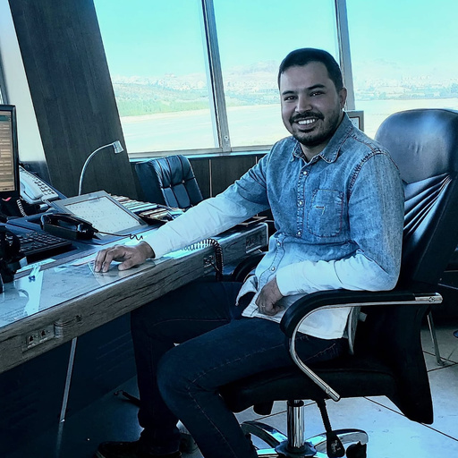
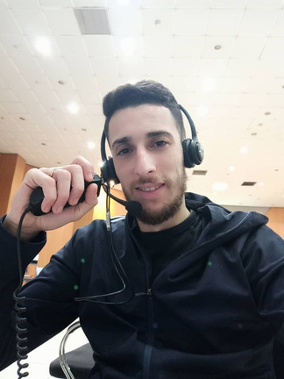
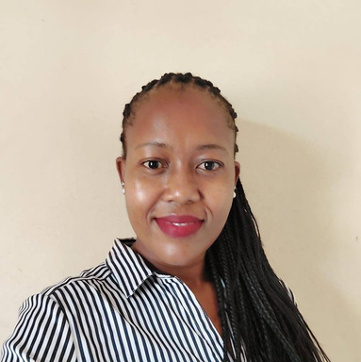
World Comms
Ramón
El-Kadur
Brittany
Nikosi
Nicola
ADCA, Dominican Republic
ADCA, Dominican Republic
NATCA, USA
Guayana ATCA
IATCA, Ireland
Kristian
Olivia
Olga
Renz
Estonia ATCA
GATCO, UK
Greece ATCA
Philippenes ATCA
Umi
Mehdi
Sid Ahmed
Maureen
IATCA< Indonesia
Iran ATCA
Algeria ATCA
Kenya ATCA

Slide 5

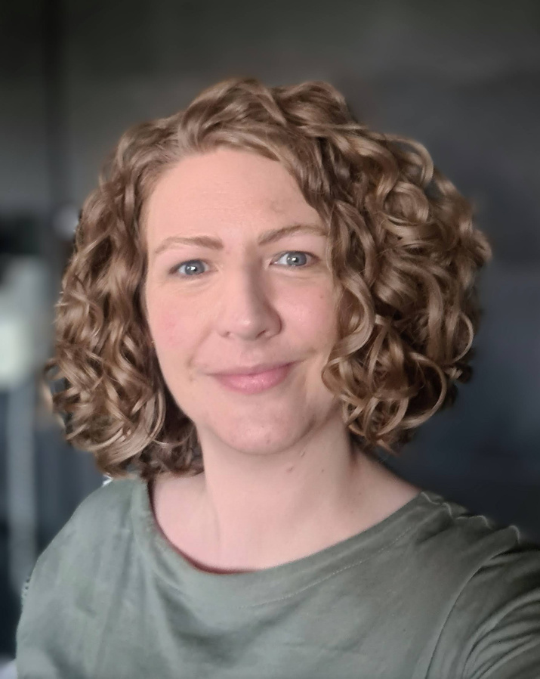
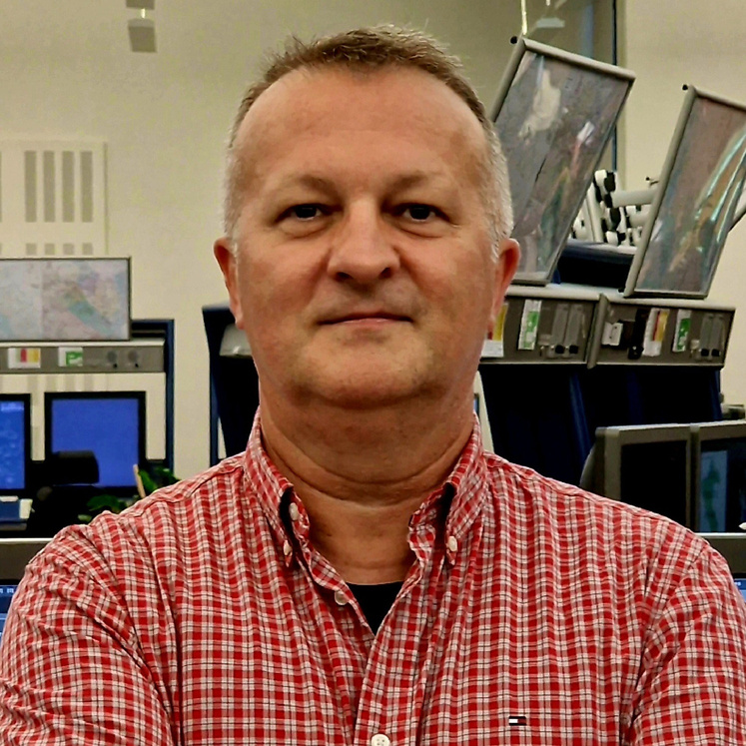
Comms
EUROPE

Slide 6


Our Team
  We try to be as representative of the region as we can, currently stretching West to the UK, North to Estonia, East to Croatia and South to Greece.
  Kristian Lavin
  Olivia May
  Olga Toki
  Zeljko Oreski

Slide 7








What we do
The Controller Magazine
Social Media
World and Local Events
Meetings and Working Groups
Information about the Federation
Industry Partner Updates
Reminders and dates
Relevant industry articles

Slide 8



Where do we get our material?
IFATCA Working Groups
Standing Committees
Recurring events
IFATCA MAs

Slide 9

Where do we get our material?
YOU
IFATCA Working Groups
Standing Committees
Recurring events
IFATCA MAs

Slide 10



Get in touch, stay in touch...
@ifatca - ...
@ifatca - Europe
@ifatca 1961
@ifatca_europe
@IFATCA
@IFATCA Europe

Slide 11
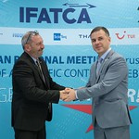
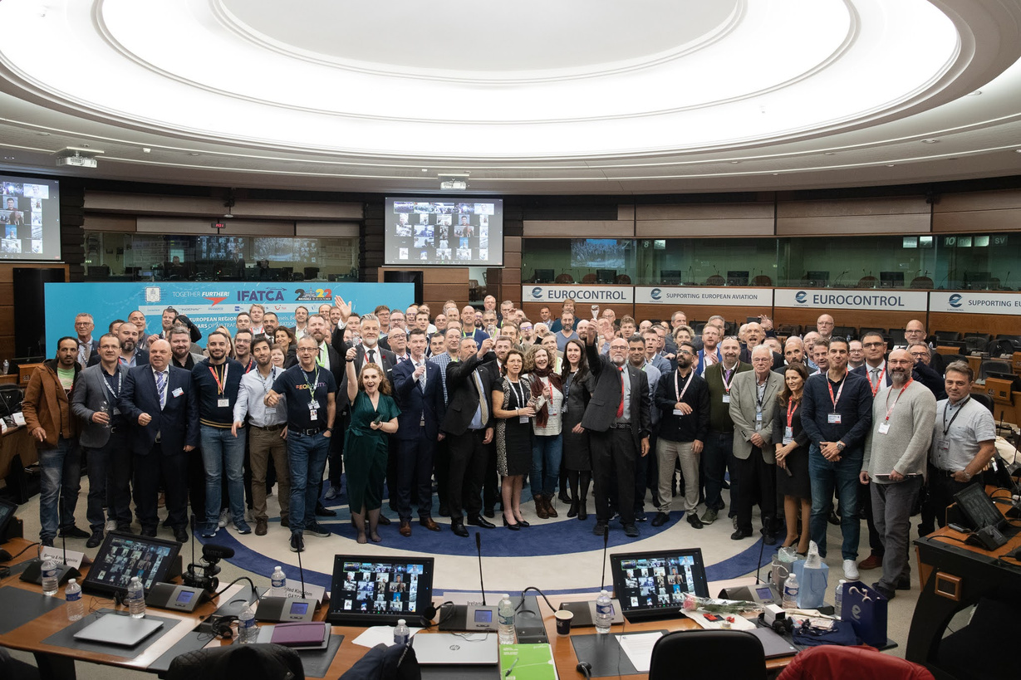

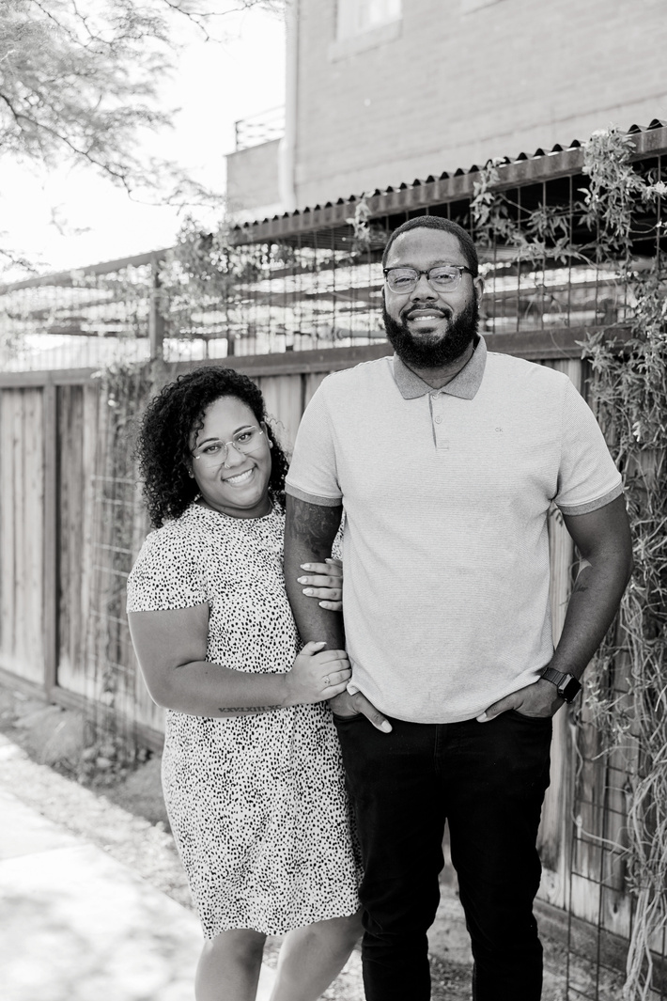
ANY QUESTIONS?

Slide 12
Those socials again...
@ifatca - ...
@ifatca - Europe
@ifatca 1961
@ifatca_europe
@IFATCA
@IFATCA Europe

