Slide 1
IFATCA
2030+

Slide 2
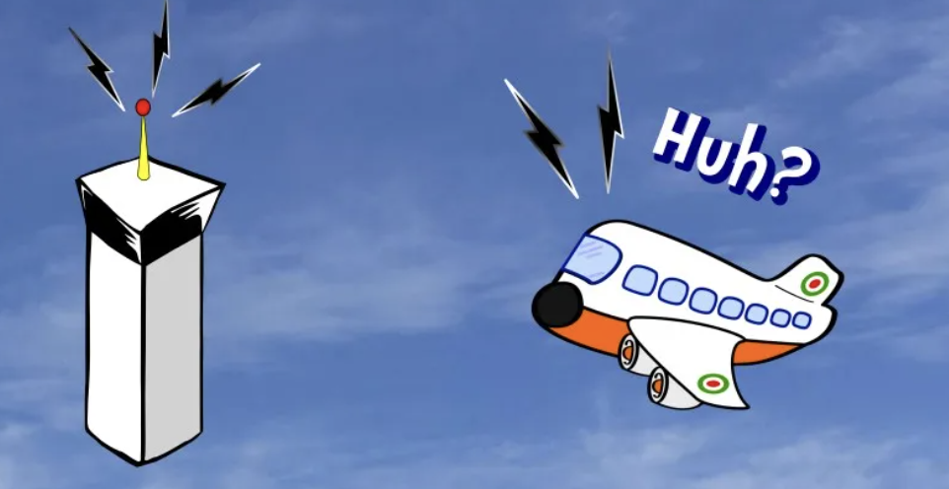
REPORT RUNWAY
IN SIGHT

Slide 3
IFATCA’s mission statement:
To enhance air traffic safety,
To promote the air traffic control profession,
To shape the future of air traffic management

Slide 4
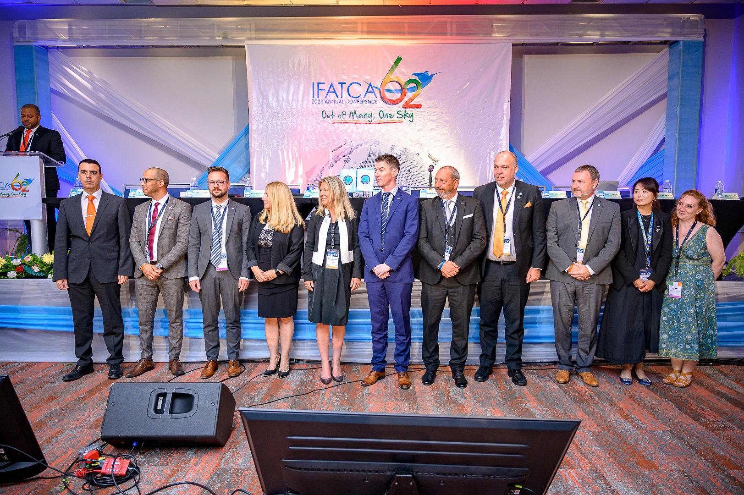

Slide 5
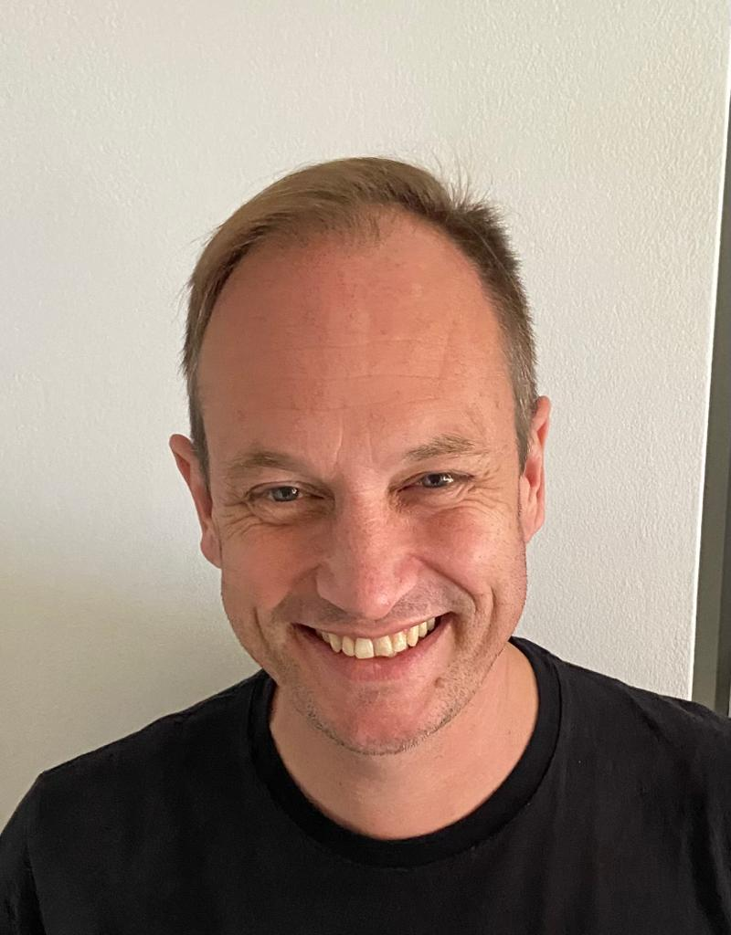
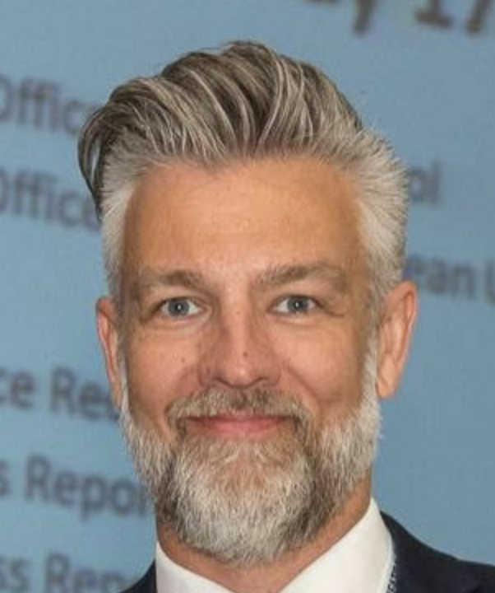
AMA
AFM
COMMS
ASP
EUR
EDITF

Slide 6
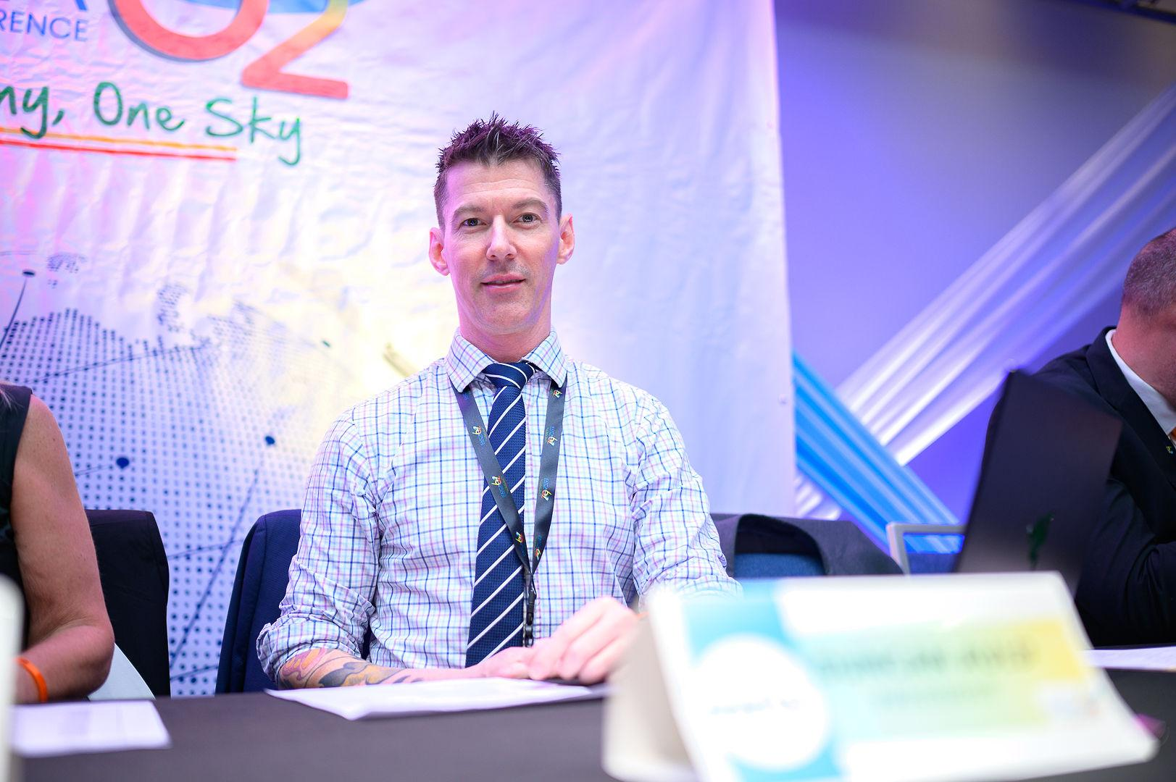
ADMINISTRATION

Slide 7
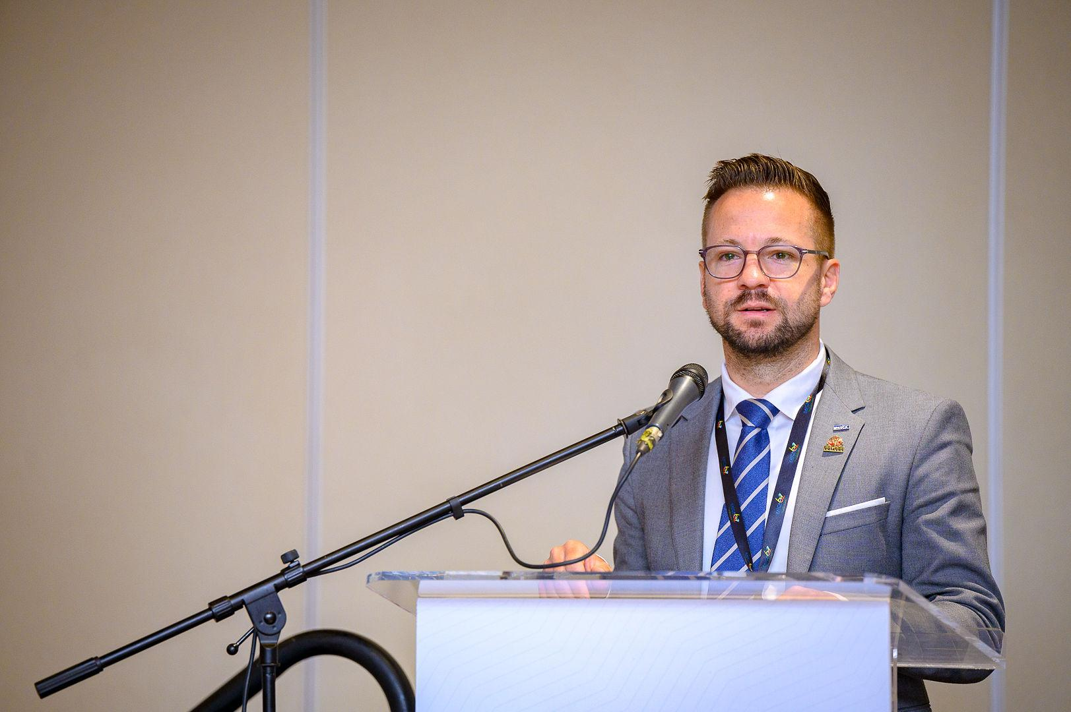
REPRESENTATION

Slide 8
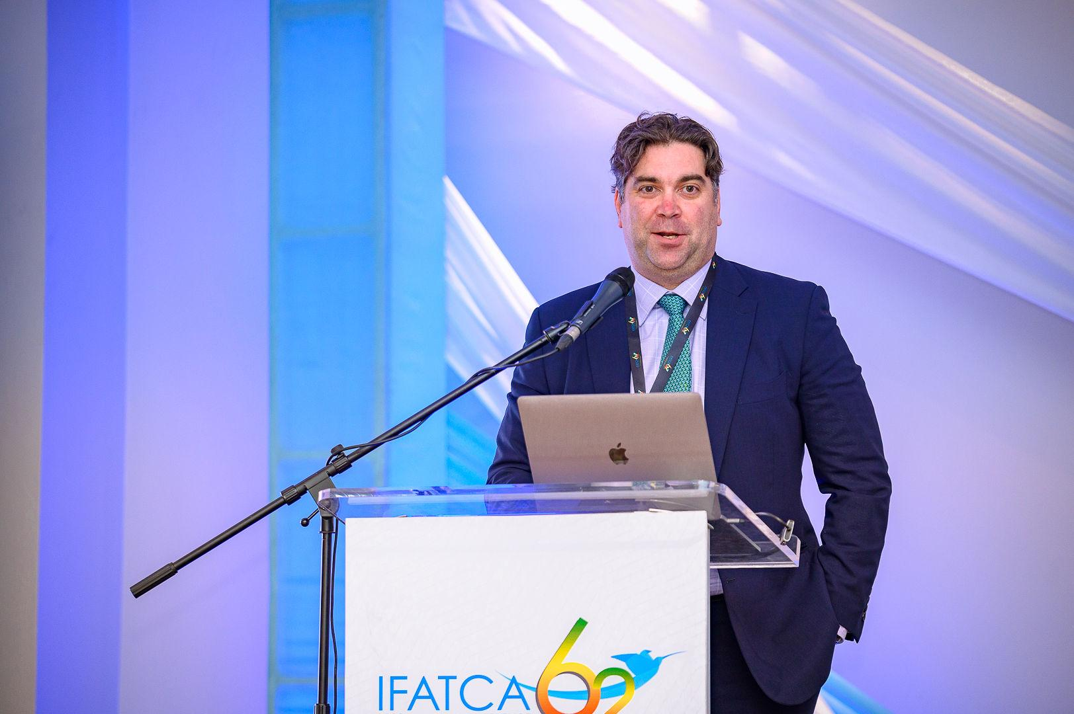
FINANCE

Slide 9
COHESION

Slide 10
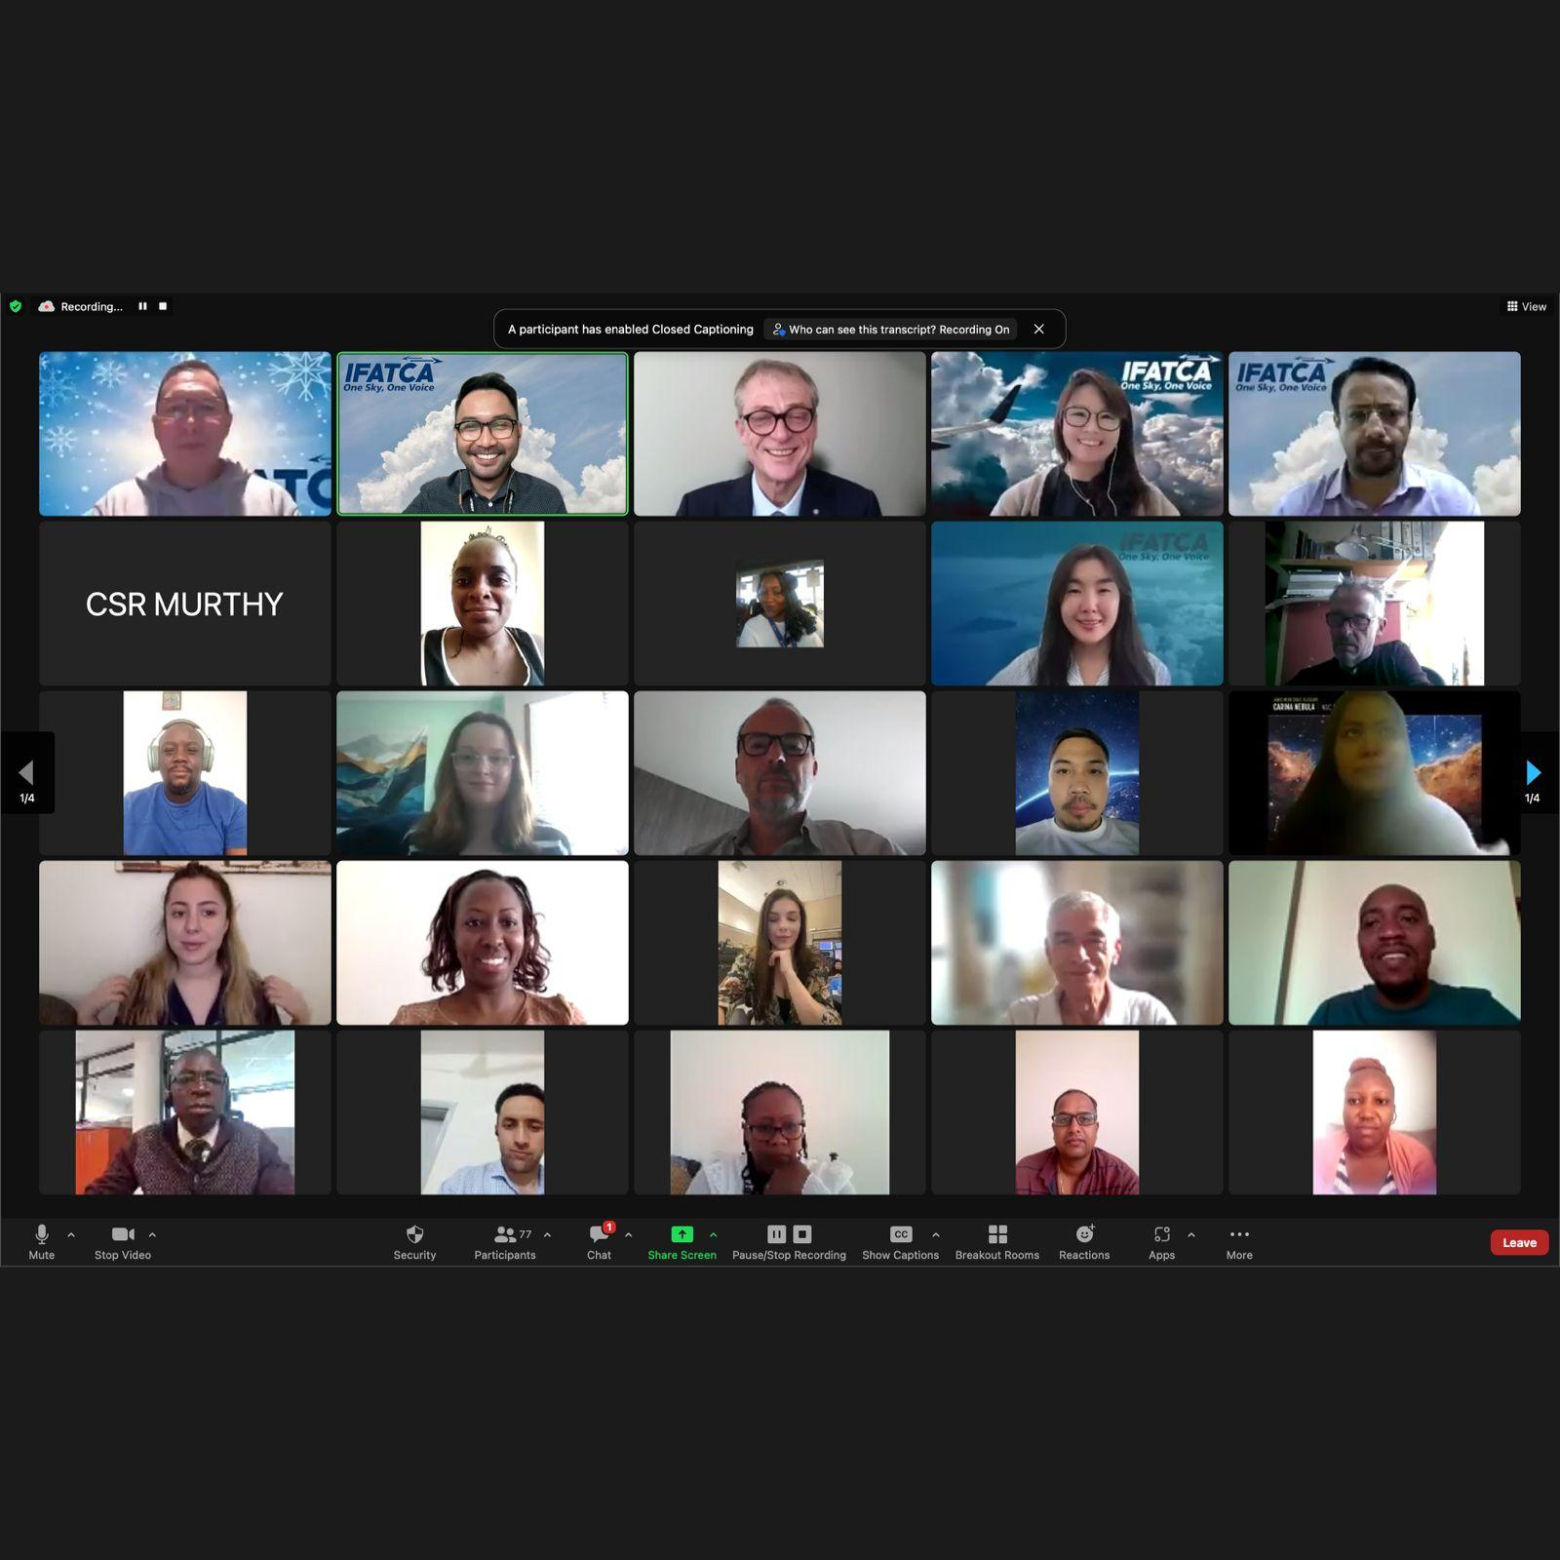
IMPLEMENTATION

Slide 11
DEVELOPMENT

Slide 12
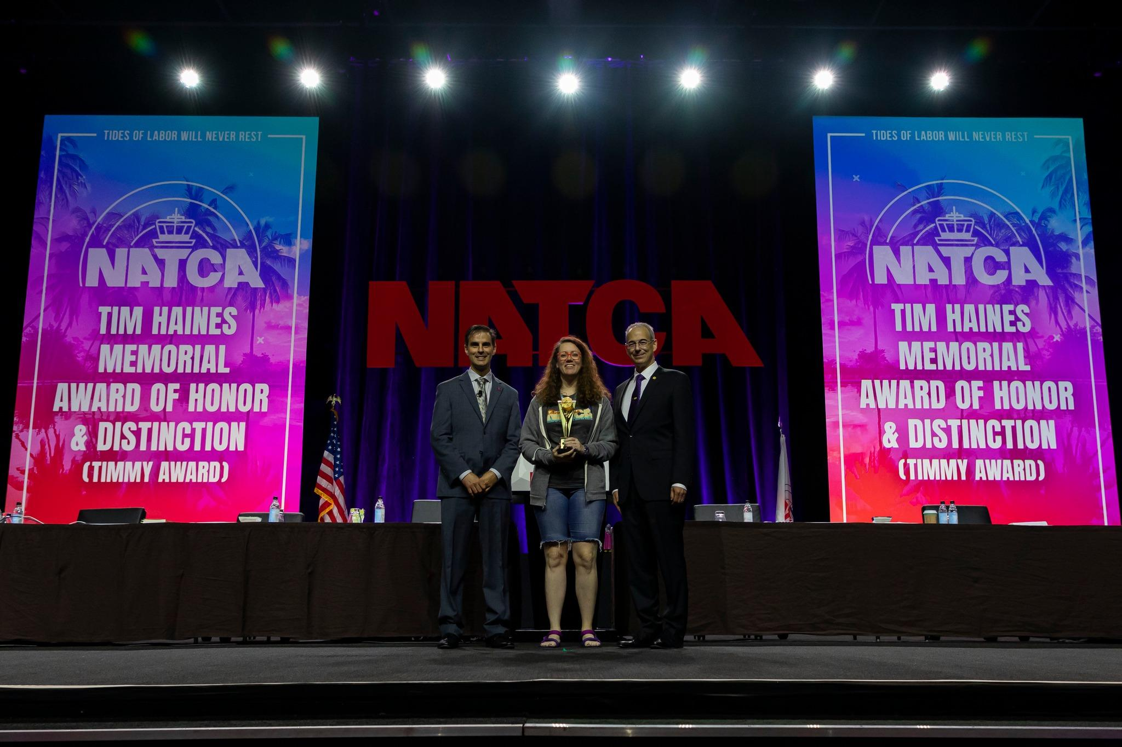
INFLUENCE

Slide 13
31
18/47
AFM
11/25 AMA
15/19
ASP
34/43
EUR

Slide 14
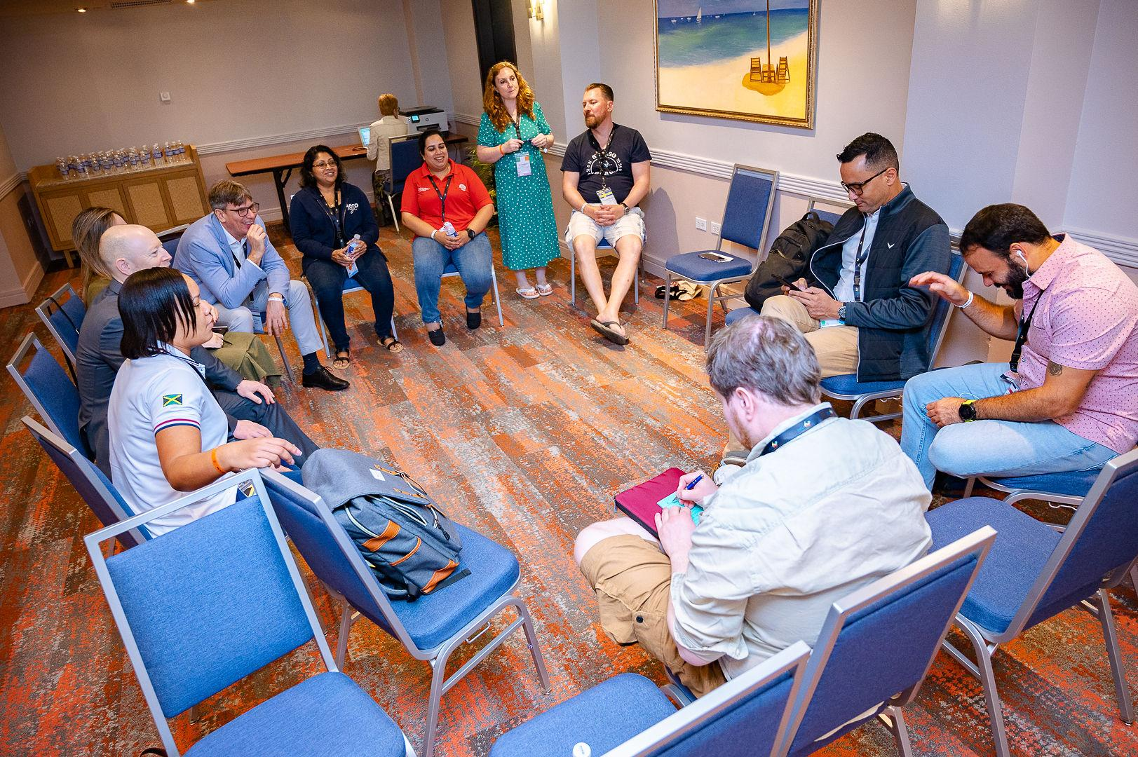

Slide 15
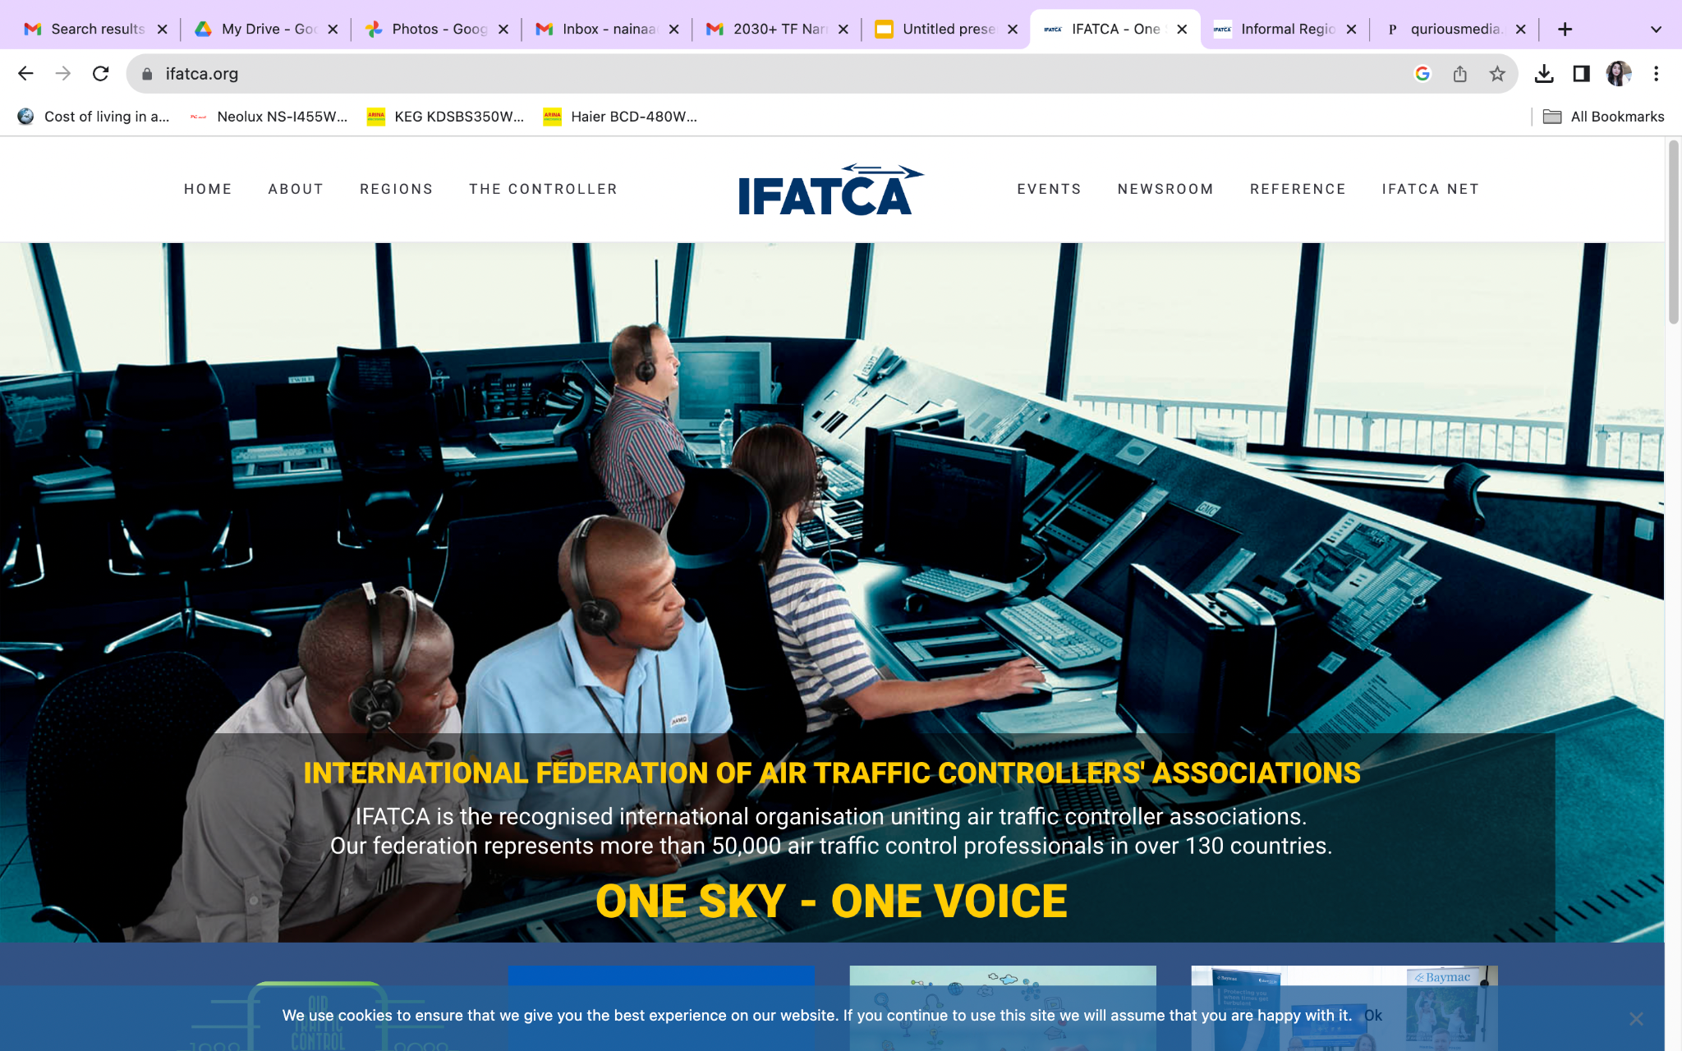
ifatca.org

Slide 16
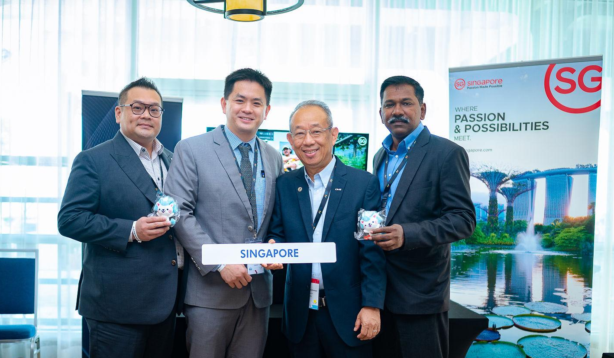
SEE YOU IN SINGAPORE!

Slide 17
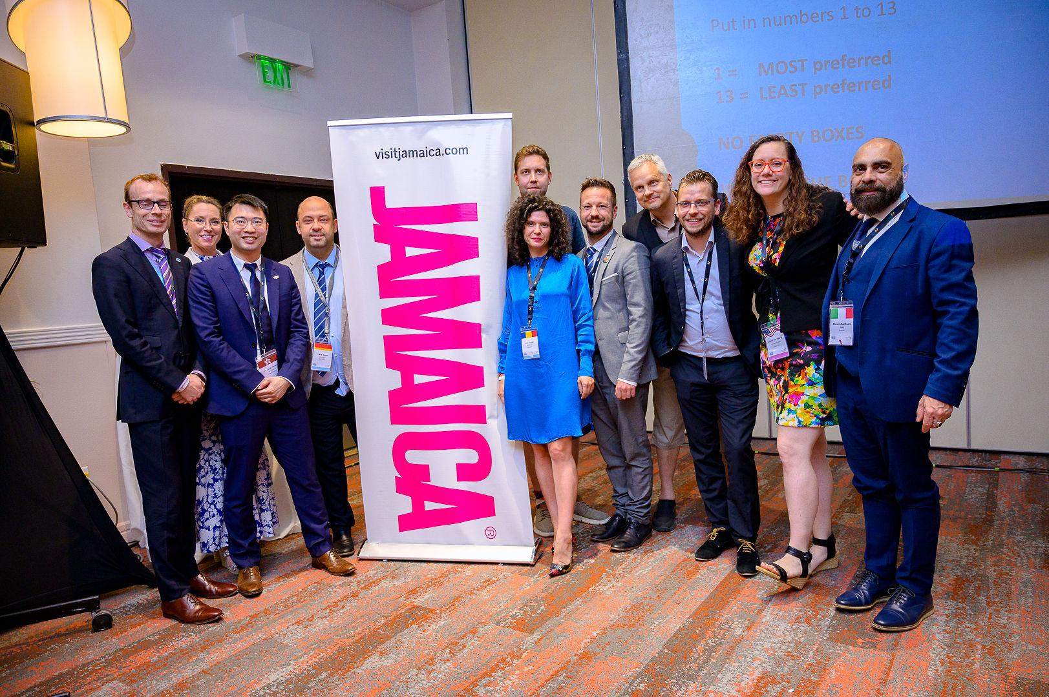

Slide 18
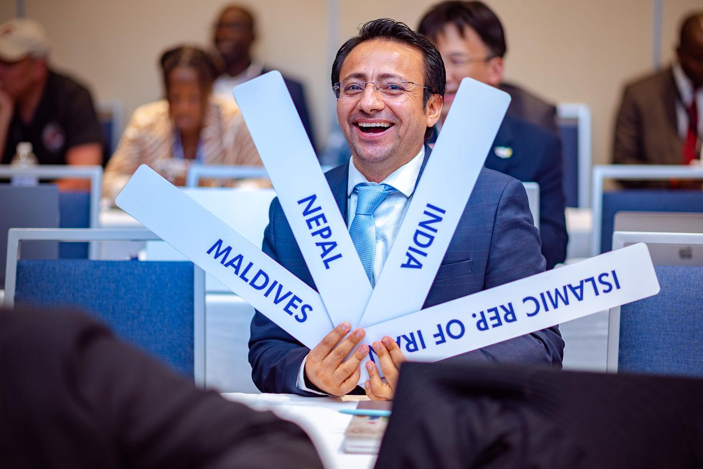
How do you want the regional meeting to be conducted?

Slide 19
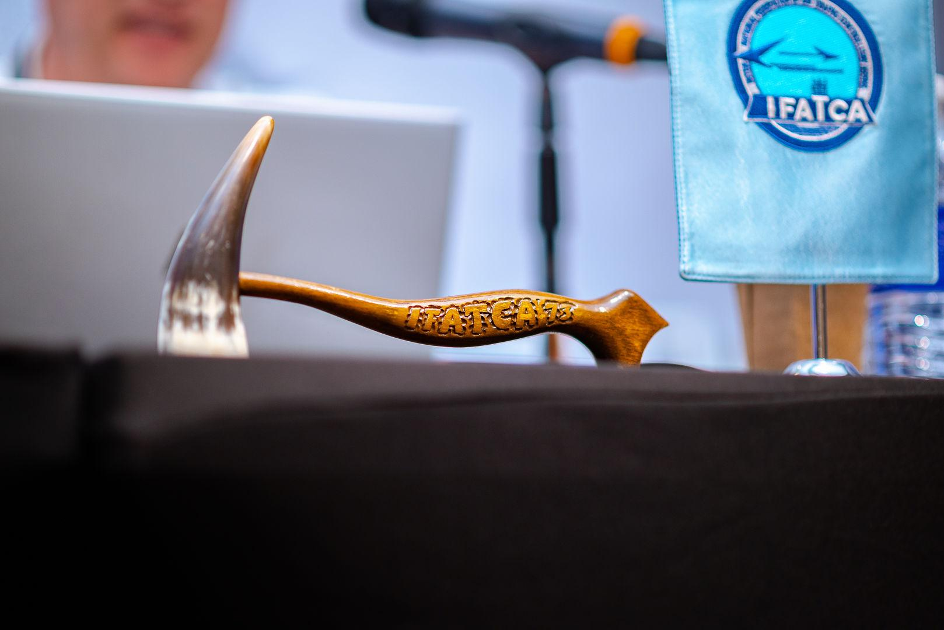
Thank you for your attention!

