Slide 1
Equity, Diversity and Inclusion Task Force
EDITF

Slide 2
IFATCA’s mission statement:
To enhance air traffic safety
To promote the air traffic control profession
To shape the future of air traffic management

Slide 3
Meet the EDITF members:
(new members in yellow)
Notes:
The EDiTF is appointed by the Executive Board.
The EDiTF consists of 10 people; one chair, one secretary plus two
members from each IFATCA region.
The current chair is Mr Sverre Ivar Elsbak, Norway.
The Secretary is Ms Maria Serrano Mulet.
The chair reports to the DP who will inform the rest of the EB of the
activities of the task force.
The chair can accept additional corresponding members.
The chair can establish separate working groups if this is considered
necessary.

Slide 4
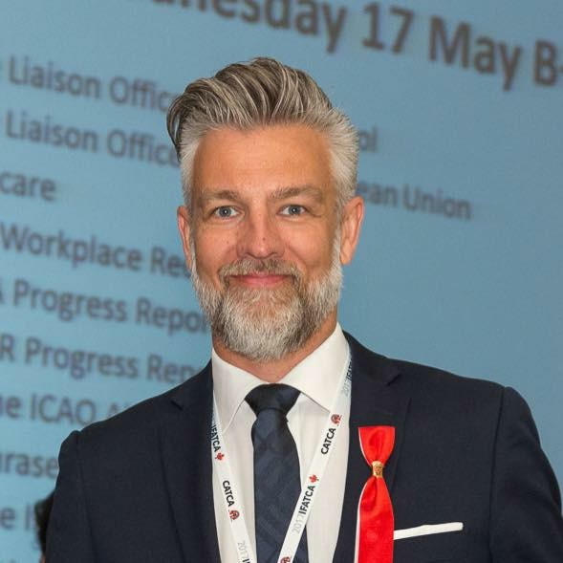
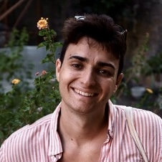
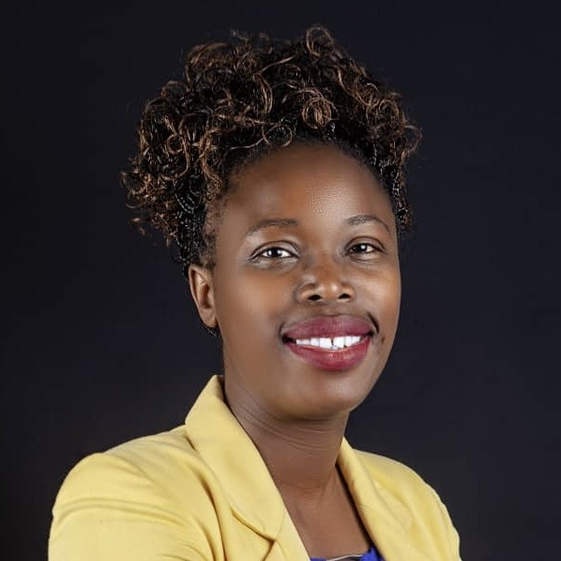
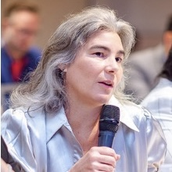
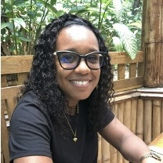
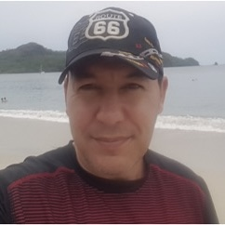
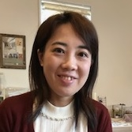
Chair
Co-Chair
EUR
AFM
Sverre
Maria
Marc
Lumbiwe
AMA
ASP
Rossana
Gale
Greg
Asuka
Notes:
The EDiTF is appointed by the Executive Board.
The EDiTF consists of 10 people; one chair, one secretary plus two
members from each IFATCA region.
The current chair is Mr Sverre Ivar Elsbak, Norway.
The Secretary is Ms Maria Serrano Mulet.
The chair reports to the DP who will inform the rest of the EB of the
activities of the task force.
The chair can accept additional corresponding members.
The chair can establish separate working groups if this is considered
necessary.

Slide 5
A bit more about your regional rep
Marc Jarc from Slovenia
25 years old
6 years ATC
Currently ACC/FIS sector Ljubljana
Automation department, PR and leads association

Slide 6
What is EDI ?

Slide 7
Equity
recognizes that each individual or MA has varying circumstances and needs, and therefore needs different resources and opportunities to reach an equitable outcome.

Slide 8
Diversity
recognizes that every individual is unique, and doesn’t limit gender, ethnicity, religion, sexual orientation, age or disability.

Slide 9
Inclusion
is when everyone has the opportunity to learn, develop, contribute and achieve while feeling safe to be themselves.

Slide 11
Why EDI ?

Slide 12
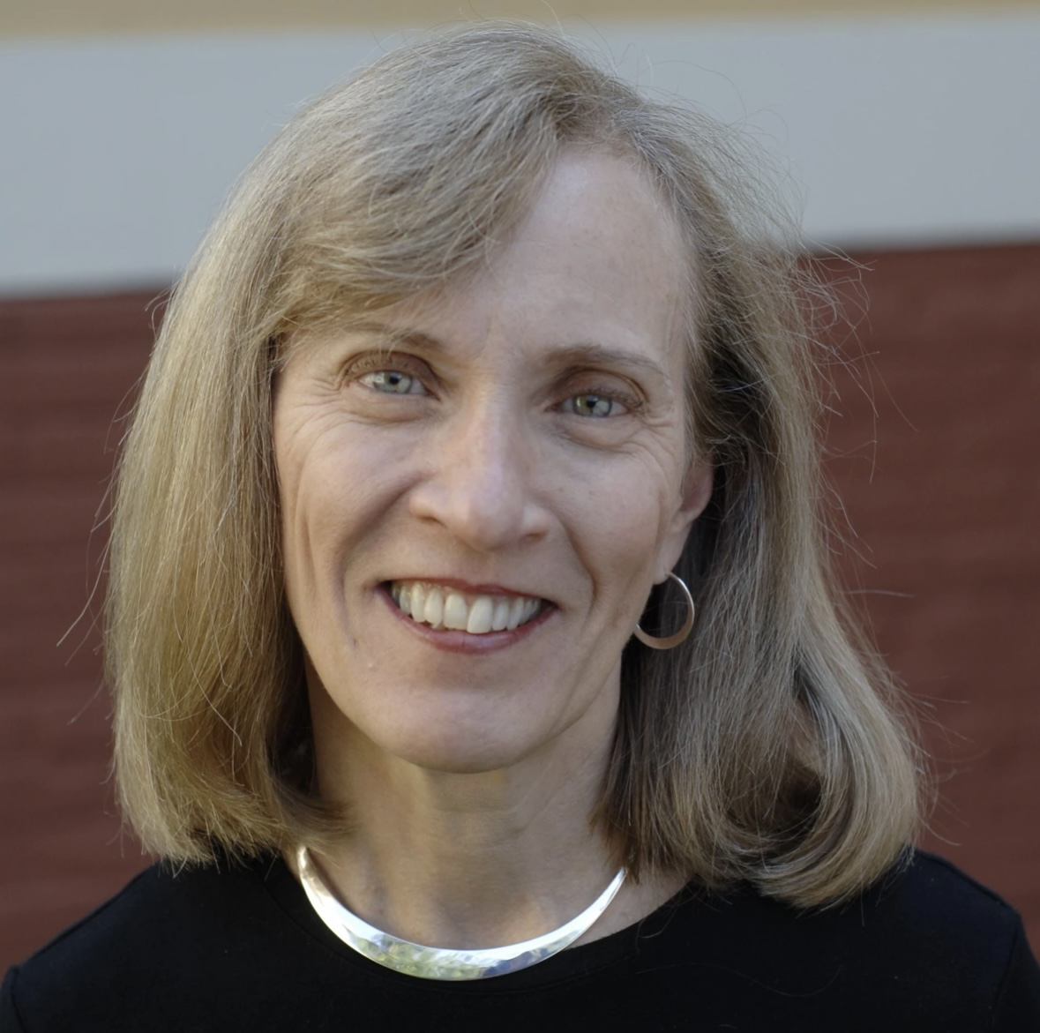
Claudia Goldin

Slide 20
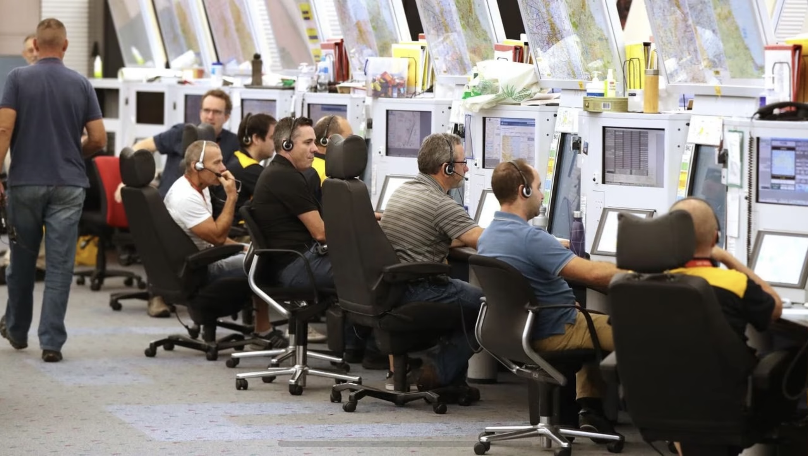

Slide 21
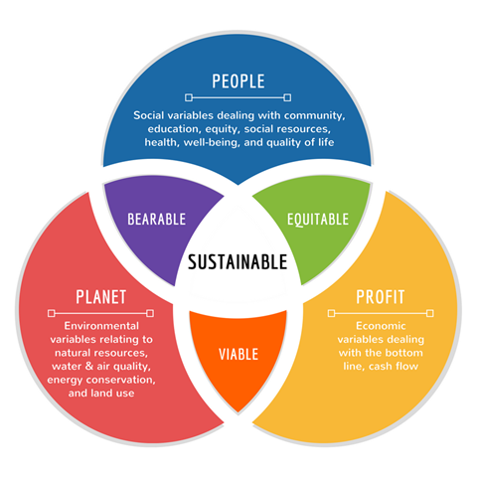

Slide 22
IFATCA’s mission statement:
To enhance air traffic safety
To promote the air traffic control profession
To shape the future of air traffic management

Slide 23
IFATCA are at the forefront of EDI within the aviation sector, getting recognition from ICAO and Eurocontrol
Notes:
Talk about lunch with Nicolas Rollo in Madrid. Eurocontrol initiative, we’ll be in work packages (4 of them)

Slide 24
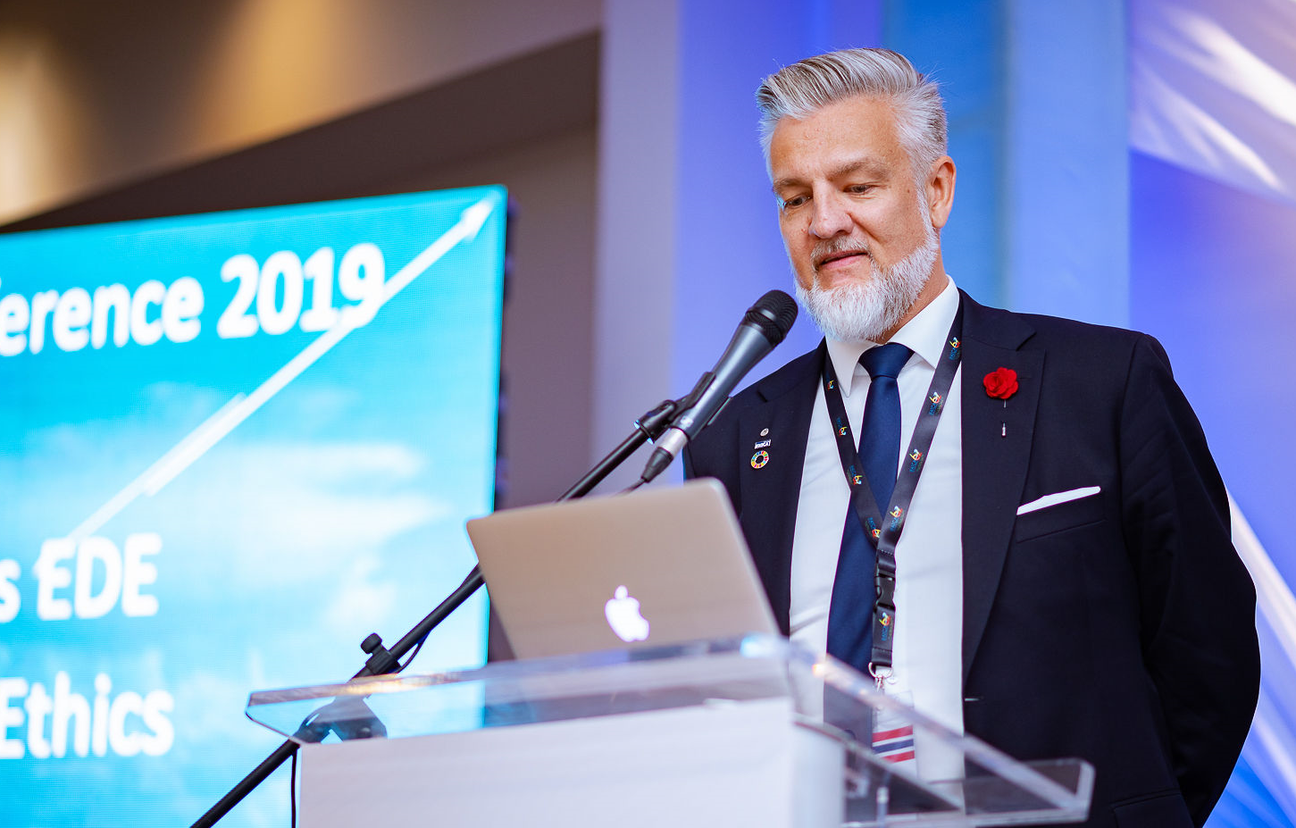
The IFATCA Equity Diversity and Inclusion plan was adopted in Jamaica 2023
https://www.ifatca.org/ifatca-net/documents-manuals-2-2/

Slide 25
Highlights from IFATCA EDI Plan:
Where possible, and without lowering standards of quality, aim towards a diverse and equal composition of representatives in IFATCA working groups, task forces, panels.
Assist Member Associations to promote Equity, Diversity and Inclusion within their own organizations.
To work with other Aviation bodies to develop examples of good practice which can be promoted to our MAs, employers and within the aviation sector.

Slide 26
IFATCA Commitment for the future:
Continuously work to promote Equity, Diversity and Inclusion within our profession.
Continue to promote Equity, Diversity and Inclusion at Regional and Annual Meetings.
Encourage all Member Associations to take action to ensure a diverse and equal composition of representatives, without lowering standards of quality, at all levels within their Association, on their executive boards and on their committees.
Provide guidance material on Equity, Diversity and Inclusion for our Member Associations.

Slide 27
The IFATCA Information Handbook was updated:
1.1.2 Members to also include the number and percentage of female members
Please make sure you update this

Slide 28
What is the EDITF working on now?

Slide 29
Working with the IFATCA Comms Team
Talk to the MA's during the Regional Meeting to get ideas on topics
Continue collaborating with IFATCA 2030+ TF
How to promote EDI at the next Annual Meeting in Singapore
Expand the collaboration with IFALPA, IFATSEA, IFIMA, IFISA and EPAN

Slide 30
How to Contact EDI?
Talk to one of us at this meeting
WhatsApp with the EDITF member of your Region
Send email to: edi.chair@ifatca.org

