Slide 1
IFATCA European Regional Workshop EASA study on Air Traffic Controllers Fatigue
Nathalie LE CAM
ATM/ANS Department
16 October 2023

Slide 2
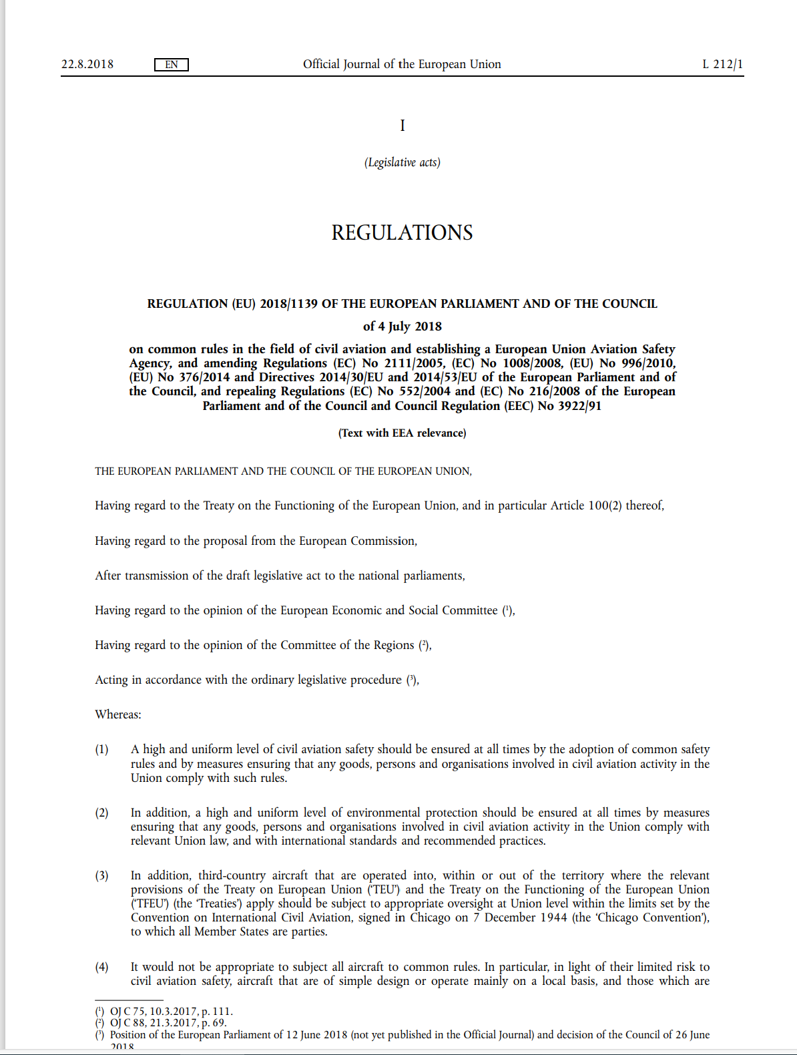
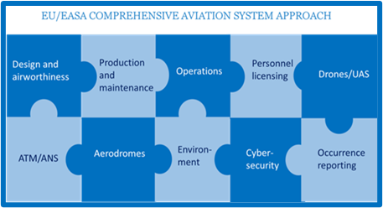
WHY ?
Since 2009
EASA Basic Regulation, art. 2 and 40 to 52
EASA Basic Regulation
A technologically/regulatory consistent approach across the various domains
EASA competent to draft rules and ensure that the provision of civil ATM/ANS in the Single European Sky airspace, as well as the design, production, maintenance and operation of ATM/ANS systems and constituents are done in conformity with EU rules and requirements:
ANS Providers
ATM/ANS systems and ATM/ANS constituents
Organisations involved in the design, production or maintenance of ATM/ANS systems and ATM/ANS constituents
Design of airspace structures
ATCOs
ATCOs training organisations
Instructors, assessors and aero-medical examiners

Slide 3
WHY NOW ? (1)
REGULATION (EU) 2015/340 of 20 February 2015 on air traffic controllers' licences and certificates
ATCOs training must include fatigue and fitness as part of Human Factors
5 years = evaluation time
REGULATION (EU) 2017/373 of 1 March 2017 on common requirements for ATM/ANS providers
ATS.OR.315 Fatigue In accordance with point ATS.OR.200, an air traffic control service provider shall:
develop and maintain a policy for the management of air traffic controllers' fatigue;
provide air traffic controllers with information programmes on the prevention of fatigue, complementing human factors training provided in accordance with Sections 3 and 4 of Subpart D of Annex I to Regulation (EU) 2015/340.
ATS.OR.300 -Prevent and mitigate the negative effects of fatigue on air traffic controllers to ensure the safety of air traffic.

Slide 4
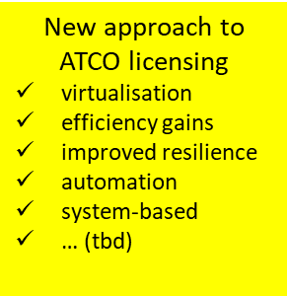
WHY NOW (2)
Other EASA actions for ATCOs
Clarify and promote the inherent flexibility of the current regulatory framework
Simplify and update existing requirements to match current operational needs
New regulatory means to implement new technologies and operational concepts
rulemaking
Regulation 2023/893
rulemaking
NPA 2023-02
study
ATCO Fatigue
deployment
rulemaking
E-license
SESAR/ATCO
https://www.easa.europa.eu/en/regulations/atco-air-traffic-controllers For questions: ATM@easa.europa.eu

Slide 5
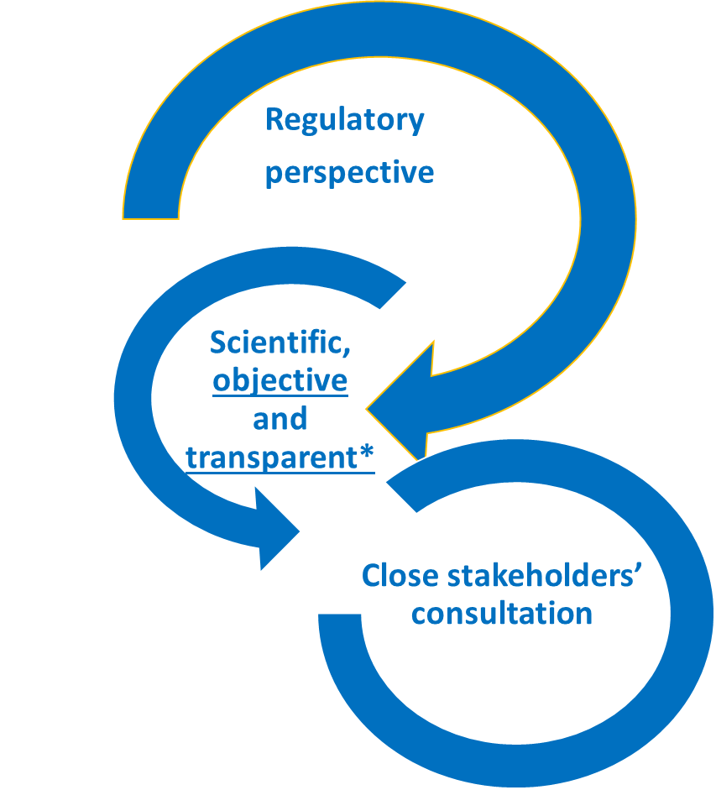
HOW ?
Study on the impact analysis, prevention and management of ATCOs fatigue in the EU
Objectives:
Address the human dimension of the Digital Single European Sky
Assess the safety impact of ATCO fatigue
Define the possible evolution of ATCOs role, workload and fatigue management
Consortium
Task 1
Evaluation of regulatory implementation
December 2022
Task 2
Scientific research and data collection
Ries Simons
Task 3
Impact of new technologies
January 2024
Details of the call for tenders: https://etendering.ted.europa.eu/cft/cft-display.html?cftId=11704
Notes:
Under Reg. 373/2017: Fatigue = a physiological state of reduced mental or physical performance capability resulting from sleep loss or extended wakefulness, circadian phase or workload (mental or physical activity, or both) that can impair an individual's alertness and ability tosafely perform his/her tasks

Slide 6
Progress status
January
February
March
April
May
June
July
August
September
October
November
December
Task 1
Evaluation of reg. implementation
Methodology + sample selection
Evaluation of implementation
Assessment of benefits/gaps
Task 2
Research and data collection
Literature review
Occurrences data collection
ATSP Sample selection and methodology
Research on fatigue causes
Research on fatigue risk management
Research on fatigue prevention and mitigation
Task 3
Impact of new technologies
Technologies’ impact on fatigue
Workshop on future technologies (SESAR)
Task 4
Communication and consultation
Stakeholders consultation
Drafting final report
Communication of end results
Task 5
Project management

Slide 7
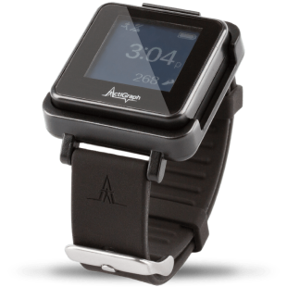
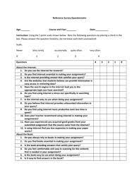
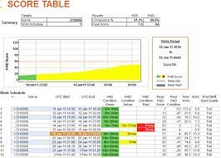
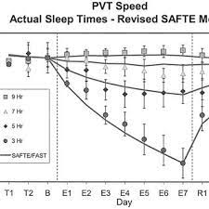
Data collection methodology
+ Inputs from literature review , gap analysis and occurrence reporting analysis
Survey with 50 ATSPs
+
with ATCOs unions and associations
Detailed
Interviews with 20 ATSPs
Roster analysis with 16 ATSPs
-
24 rosters analysed through 2 biomathematical models
Subjective measurement campaign in 5 ATSPs(all ATCOs)
Questionnaires + mobile app
Validation by objective measurement campaign in 5ATSPs/20 ATCOs-
PVT, actigraphs and eye tracking
April-May
July –Sept.
August-October
FAID model
SAFTE-FAST model

Slide 8
ATSPs involved
Survey questionnaire sent to 50 EU ATSPs week 13 : nearly 70% response rate
Survey questionnaire for ATCOs through ATCEUC, ETF and IFATCA
Interviews with a sample of 18 ATSPs
Roster analysis with 16 ATSPs
Subjective and objective measurements with ATCOs of 5 ATSPs
DSNA
MUAC
ENAIRE
ENAV
PANSA
ROMATSA
LFV
skyguide
DFS
Hungarocontrol
AirNav (IE)
LGS
Austro Ctrl
SEARCO
Aircraft Industries
ANS CZ
LVNL
SAAB Digital air traffic solutions
Criteria to select the sample of 18 ATSPs
En-route/aerodrome
Volume of traffic
Geographical distribution
Diversity of legal status
ATCO productivity
Willingness to participate

Slide 9
Stakeholders’ consultation
Several consultations through EASA bodies:
ATCO SG: 19 April, June, September, December
ATM/ANS Technical Committee: 20 April, 30 November
ATM/ANS Technical Board: 4 May, 30 November
MAB: 1 March, May, 5 October
SAB: 21 June, 14 November
ATM/ANS CAG: 21 March, 28 June , 11 October
HF CAG: June and October
ASPReT: 1 June
Dedicated Workshops/Webinars: 16 June, 8 December
Joint Workshop with SESAR JU on new technologies: 12 October
+ Possible bilaterals with specific stakeholders
April
May
June
September
October
November

Slide 10
WHAT NEXT ?
For the study:
End November: end of data collection campaign
8 December: public online Workshop on initial results
February 2024: final dissemination event
For EASA:
Analysis of results
Proposals to EASA consultative bodies in Spring 2024

Slide 11
Thank you
Contact: nathalie.le-cam@easa.europa.eu

