Slide 1
ATSEP organisation at Maastricht UAC
Supporting European Aviation
Fatigue Field experience in the EUROCONTROL member states
Fabrice Drogoul HF and Safety expert
EUROCONTROL NMD

Slide 2
EUROCONTROL field studies
ROSTER EVALUATION
WEB
SURVEY
Stress and other factors
Workload and FOCUS
GROUPS
SLEEP DURATION AND QUALITY
Notes:
Need to assess in the field to capture the other factors that constrained the rostering: social negociations, preferences, Operational demand, culture…

Slide 3
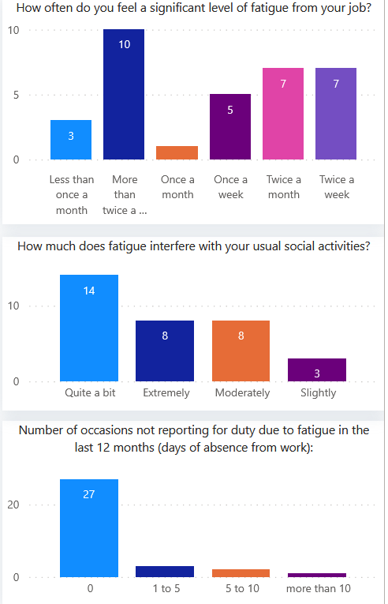
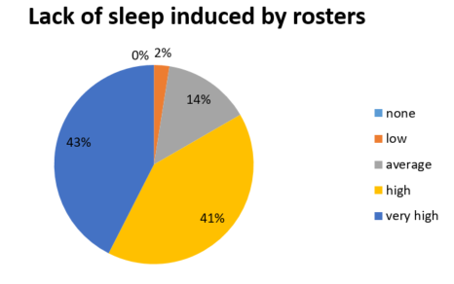
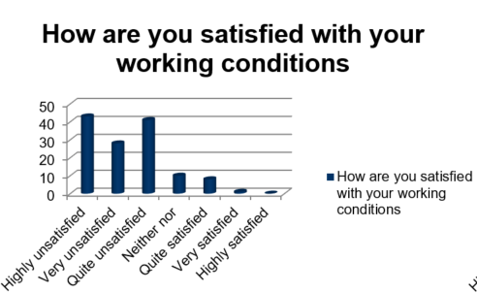
Plenty of data available from Various ANSP

Slide 4
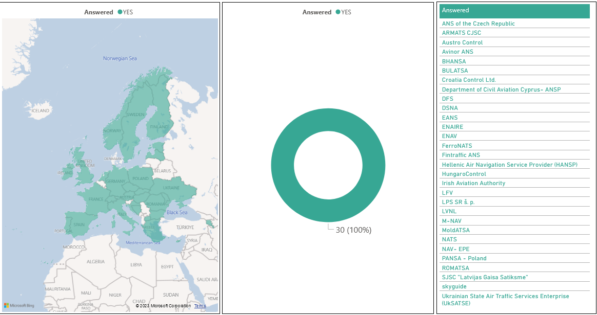
Notes:
All results from the survey are pointing to a clear need of setting prescriptive limits for fatigue management.

Slide 5
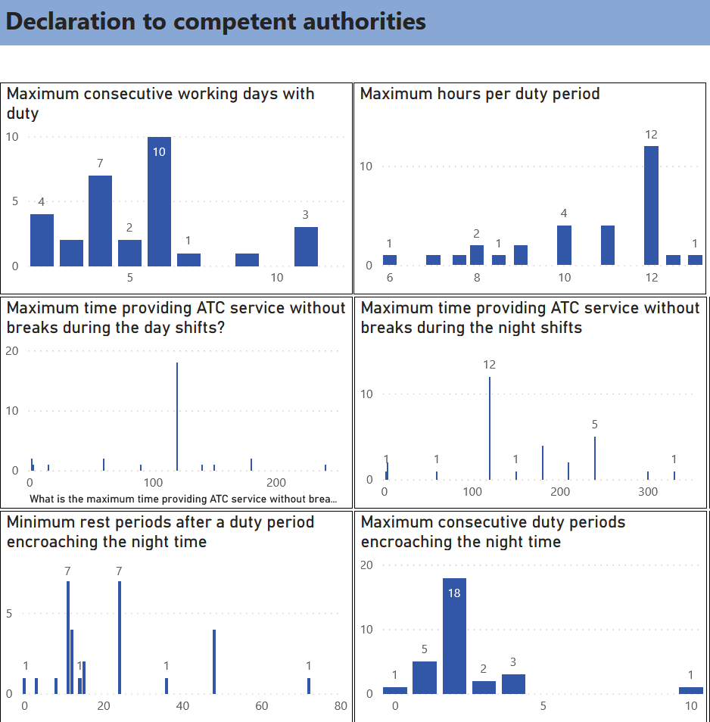

Slide 6
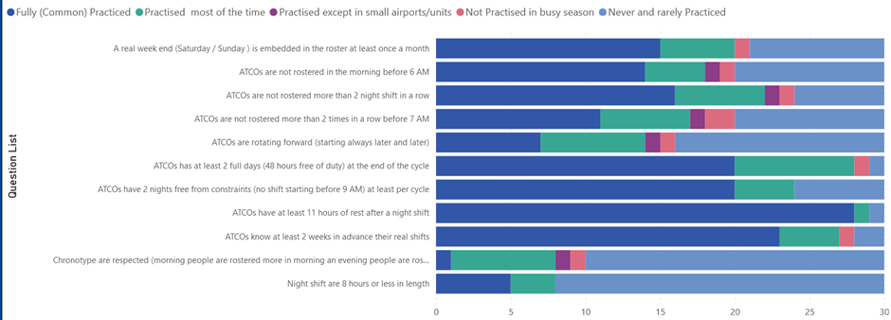
Notes:
All results from the survey are pointing to a clear need of setting prescriptive limits for fatigue management.

Slide 7
Some issues identified from the field
Some ANPS do not have a rostering system in place (rostering system = patterns of shift and rostering) Then it is difficult to have a prescriptive approach.
Some ANSP have a rostering system but with very few limits… and since the introduction of the EU Regulation 373 they have added a couple of constraints and they declare that they are doing FRMS.
Some ANSP average data over the year (busy summer is compensated by quiet winter)
Some ANSP manage fatigue only for operational hours…

Slide 8
FRM will never compensate for staffing shortage…
FRM and FRMS are additional cost… that can bring mid term to long term benefits and return on investment
We are not good at assessing our own level of Fatigue. Other influences play a big role in the choice of our rosters.

Slide 9
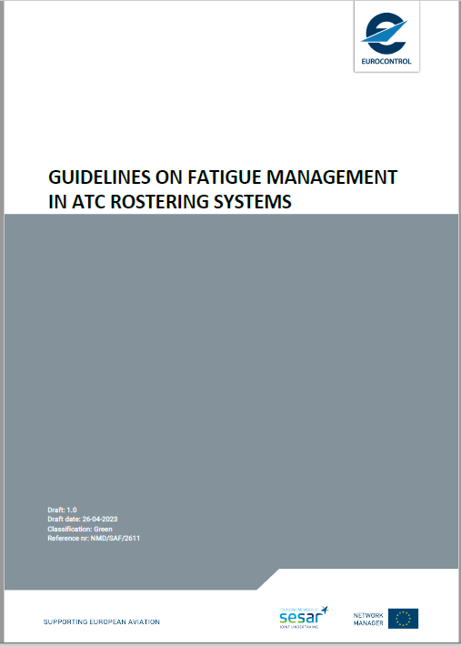
Guidelines on fatigue for rostering
Notes:
In 2021 EUROCONTROL took the opportunity to survey its 41 states on their rostering practices. All ANSPs were addressed at the level of COO. So far there is no numbers provided as acceptable levels in the regulation or acceptable means of compliance (AMC). Huge discrepancies can be seen between ANSPs.

Slide 10
General recommendations for rostering (EUROCONTROL/ANSP coo document 2023)
Shift cycle length
Maximum consecutive working days with duty |  | 5 days or fewer duties there are no extra constraints on the number of rest days
 | or a maximum 6 consecutive duty days (without off days), allowing 54 hours of rest (2 consecutive nights and no duty starting early morning).
Night duties
Number of consecutive night duties |  | Maximum 2
Number of days-off after night duties
 | After 1 night shift
 | After 2 night shifts or more
Night duties
Number of consecutive night duties |  | Maximum 2
Number of days-off after night duties
 | After 1 night shift | 1 night free from duty (no duty starting before 9.00)
 | After 2 night shifts or more
Night duties
Number of consecutive night duties
Number of days-off after night duties
 | After 1 night shift
 | After 2 night shifts or more
Notes:
The recommendations:
• take into account the need for regular nights without constraint and the need to socialise and rest at the same ratio of days at work and days off as other workers;
• should not be averaged over the year. In the case of seasonal traffic, having 3 days off every 4 days in winter and autumn does not justify one day off every 10 days for the summer.
For example: up to 4 consecutive days allow 30 hrs., after 5/6 days allow 54 hrs.

Slide 11
General recommendations for rostering (EUROCONTROL/ANSP coo document 2023)
Shift duration
Maximum hours per duty period |  | The maximum hours per duty period should not exceed 8 hours.
 | It is recommended, that non-ops duties are included as an intrinsic part of rosters If the maximum hours per duty period exceeds 8 hours, it should be validated by a safety risk assessment The safety risk assessment in this case needs to demonstrate that increased working time over 8 hours does not increase fatigue risk and the length of a duty period should never exceed 12 hours. maximum allowed overtime may be self-regulated provided the fatigue guidelines any overtime used does not exceed the prescribed fatigue limitations.
Night duties
Number of consecutive night duties |  | Maximum 2
Number of days-off after night duties
 | After 1 night shift
 | After 2 night shifts or more
Night duties
Number of consecutive night duties |  | Maximum 2
Number of days-off after night duties
 | After 1 night shift | 1 night free from duty (no duty starting before 9.00)
 | After 2 night shifts or more
Night duties
Number of consecutive night duties
Number of days-off after night duties
 | After 1 night shift
 | After 2 night shifts or more

Slide 12
General recommendations for rostering (EUROCONTROL/ANSP coo document 2023)
Maximum time providing air traffic control service without breaks
maximum time providing an ATC service |  | 2 hours
 | The break intervals should be reviewed periodically or when an increase in traffic load is experienced Air Traffic Services Units (ATSUs) experiencing low traffic loads for prolonged periods, may extend shift sessions to 3 hours. Non-surveillance traffic services (e.g.,Towers) may provide air traffic services shift sessions up to 4 hours if traffic and complexity is low Digital/remote towers should be considered as ATS Units performing services with surveillance. The recommended maximum time working in position should be no longer than 2 hours or 3 hours respectively, as explained above
Night duties
Number of consecutive night duties |  | Maximum 2
Number of days-off after night duties
 | After 1 night shift
 | After 2 night shifts or more
Night duties
Number of consecutive night duties |  | Maximum 2
Number of days-off after night duties
 | After 1 night shift | 1 night free from duty (no duty starting before 9.00)
 | After 2 night shifts or more
Night duties
Number of consecutive night duties
Number of days-off after night duties
 | After 1 night shift
 | After 2 night shifts or more

Slide 13
General recommendations for rostering (EUROCONTROL/ANSP coo document 2023)
The ratio of duty periods to breaks when providing ATC service
The minimum duration of a break |  | should be 30 minutes
 | Breaks should be more frequent during night shift Beyond the need for a 30-minute break, the enforcement of a specific ratio of duty period to break is not as essential as it relates strongly to the length of service. For example for fatigue prevention, a shift of 4h30 with 2h of sector time, then a break of 30 minutes, then 2h of sector time (ratio of 80% work and 20 % break) is better than an enforcement of 25 % break on a shift of 11h
Night duties
Number of consecutive night duties |  | Maximum 2
Number of days-off after night duties
 | After 1 night shift
 | After 2 night shifts or more
Night duties
Number of consecutive night duties |  | Maximum 2
Number of days-off after night duties
 | After 1 night shift | 1 night free from duty (no duty starting before 9.00)
 | After 2 night shifts or more
Night duties
Number of consecutive night duties
Number of days-off after night duties
 | After 1 night shift
 | After 2 night shifts or more
Notes:
• Beyond the need for a 30-minute break, the enforcement of a specific ratio of duty period to break is not as essential as it relates strongly to the length of service. For example for fatigue prevention, a shift of 4h30 with 2h of sector time, then a break of 30 minutes, then 2h of sector time (ratio of 80% work and 20 % break) is better than an enforcement of 25 % break on a shift of 11h. Different values may be established in conjunction with different duty period lengths.

Slide 14
General recommendations for rostering (EUROCONTROL/ANSP coo document 2023)
Minimum rest periods
Minimum rest period after a duty period |  | should be 11 hours
 | It is recommended that this should not be deviated from, e.g. by allowing ATCOs to decide if they want a shorter recovery time.
Notes:
which is calculated for 8 hours sleep plus 3 hours for commuting and eat to allow for adequate time that includes rest, sleep, meals, preparing for sleep and personal administration.
A possible equivalent criterion might be: “not less than the length of the duty period and in any case not less than 8 hours”;
The motivation of extra income or condensed shift allowing longer period off after a cycle do not permit additional fatigue risk.

Slide 15
General recommendations for rostering (EUROCONTROL/ANSP coo document 2023)
Maximum consecutive duty periods encroaching the night time
Maximum consecutive ATCO duty periods encroaching the night period (00:00 to 06.00) |  | should not exceed 2
 | should be followed by at least a 48-hour rest period by the end of the second ATCO duty period encroaching the night-time.
- Adaptation to night shifts is very slow as the body clock is resistant to changes
- Folkard & Tucker. (2003) have shown that the risk of accident increases significantly after the third consecutive night shift
Notes:
if applicable, depending upon the operating hours of the air traffic control unit concerned
Some ANSPs would argue that they encroach the night-time just for 30 minutes or an hour and this limitation is extreme for them but in the development of good practice and the introduction of Fatigue Risk Management System (FRMS) the first step of prescriptive limits need to be absolute. Later on, when data collection will be in place, an optimal FRMS could be put in place, which demonstrates the acceptable level of derogation.

Slide 16
General recommendations for rostering (EUROCONTROL/ANSP coo document 2023)
Minimum rest period after a duty period encroaching the night-time
after 1 night shift inside the duty cycle |  | 1 night free from duty (the next shift should start after one night and not before 09.00)
after 1 night shift at the end of the cycle |  | Minimum 2 nights free from duty, e.g.. after 1 night shift ATCOs get 1 sleeping day + 1 day off (one unlimited free night plus a second free night).
 | The sleeping day is not a day off. After a night shift ending at 06.00, 07.00 or 08.00 AM the period from 07.00 or 08.00 until the next morning is to recover from sleep deprivation for the night duty. The day off will start day 24 hours after the ending time of the night shift.

Slide 17
General recommendations for rostering (EUROCONTROL/ANSP coo document 2023)
Minimum number of rest periods within a roster cycle
Number of sets of 2 or more consecutive days off |  | 3 per month
 | It is important to ensure regular weekends (i.e., one Saturday & Sunday per month in Europe) are embedded where possible in roster cycle to enable the ATCO to unwind and recover from fatigue and keep social contact with family and friends.

Slide 18
General recommendations for rostering
General
Rate of rotation | Rotate shifts quickly—no more than 2 days on any one shift to avoid the body clock to start to ajust
Direction of rotation | Rotate shifts forward (ie, morning, afternoon, night) to respect the natural trend of the body clock to delay
Non ops duty | It is recommended, that non-OPS duties are included as an intrinsic part of rosters, considering their potential impact with reference to the fatigue principles
Stand-by duties | on-call duties on site or at home should be part of the rostering system within fatigue limits
Schedule stability | Avoid as much as possible changes in the schedule
Schedule predictability | Time of day for potential duty should be predictable and consistent and the number of consecutive days that an individual may be subject to be assigned unscheduled duties should be limited.
Notes:
Some ANSPs are not counting these tasks in the ATCOs rosters, or do not include those duties in the protection and limits for fatigue, claiming they are not safety critical. Although this is true in terms of fatigue risks while performing such non-OPS duties, they anyhow limit the ATCOs’ opportunities for resting possibilities, thus becoming fatigue factors when ATCOs switch back to operational duties.
Scientific research has demonstrated that on-call duties produce fatigue and should be taken into account

Slide 19
Other fatigue related work
Study: Inter-individual measures on psychophysiological components of shift work in ATC
Study the impact of underload and monotony
Development of a Fatigue Monitoring Toolkit
Integrate fatigue measurements in HP assessment process of SESAR

Slide 20
Notes:
The EUROCONTROL document provides guidelines for managing risks from occupational fatigue in air traffic control (ATC) units. It is based on scientific studies of mostly busy ATC centers and is recommended for use in less busy ATC units. The guidelines are derived from the eight parameters of EU373/2017 and should be used in conjunction with other elements to create a balanced and effective rostering system.

