Slide 1
Air Traffic Controllers Fatigue:
A review of scientific foundations
Philippe Cabon, PhD,
Welbees & Université Paris Cité
IFATCA European Regional Meeting,
Riga, 16 October

Slide 2
Occupational fatigue is a health, safety, and productivity issue
Involved in more than 20% of fatal accidents in the transportation industry
Contributing factor to several major industrial accidents
Reduces operational performance (absenteeism, presenteism, decrease in motivation, workplace accidents, etc.)
Irregular working hours contribute to long term effects on health
Notes:
Fatigue is estimated to cost employers about $136 billion a year in health-related lost productivity, and more than 70 million Americans suffer from a sleep disorder.
www.aviationpros.com
www.NCS.org

Slide 3
Definition
A scientific definition of fatigue : “a drive for a recuperative rest”
Recovery
Effort-related fatigue
Rest
Sleep-related fatigue
Workload
Muscular
Mental
Psychological
Circadian Rhythms
Waking time
Sleep
Efforts
Impaired performance
Physiological resources
Adapted from Folkard, 2008

Slide 4
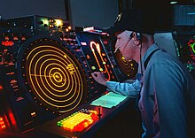
ATCOs Fatigue factors
Disruptive work schedules
Mental Workload
Stress
Environmental factors (noise, light,…)

Slide 5
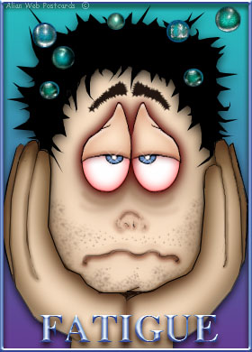
Alertness components: the 3-process model
Process C (Clock)
Alertness
WOCL
Process W (Waking, sleep inertia)
0
2
4
6
8
10
12
14
16
18
20
22
24
Rythmes circadiens : environ 24 heures en présence des synchroniseurs (Jour-Nuit, rythmes sociaux,…)
60
Time of day (h)
54
48
42
Process S (sleep)
36
Alertness
30
24
18
12
6
Fatigue
0
0
2
4
6
8
10
12
14
16
18
Time since sleep (h)
Notes:
The circadian cycle organises human behaviours along the alternations:
Day / waking state
Night / sleep
The first thing to understand about fatigue is that human is, by essence, a diurnal specie. All our functions (biological or psychological) are controlled by a body clock This is also called the process C
A second process that is controlling our alertness is called process S (sleep) or sleep pressure. It increases with the time awake. Sleep onset occurs when process S reaches a high threshold (H) and wake-up occurs when S drops below a low (L) threshold
The sleep-wake cycle, is regulated by two separate biological mechanisms in the body, which interact together and balance each other. This model, first posited by the Swiss sleep researcher Alexander Borbély in the early 1980s, is often referred to as the two-process model of sleep-wake regulation. The two processes are:
circadian rhythm, also known as Process C, the regulation of the body's internal processes and alertness levels (including the circadian drive for arousal and circadian alerting system), which is governed by the internal biological or circadian clock;
sleep-wake homeostasis, or Process S, the accumulation of hypnogenic (sleep-inducing) substances in the brain, which generates a homeostatic sleep drive.
Alexander Borbély, a Swiss pharmacologist and sleep researcher who began his research by studying sleep regulation in laboratory rats under diverse controlled conditions (Borbély & Neuhaus, 1979) applied the concept of homeostasis to sleep regulation.
Sleep homeostasis: regulated balance between sleep and waking. Homeostatic mechanisms counteract deviations from an average reference level of sleep (Borbély, 1980) .
Based on animal studies, Borbély postulated that a sleep-wake dependent and a circadian process underlie sleep regulation (Borbély 1980). This concept was extended to human sleep (Borbély 1982) and further elaborated by Serge Daan, Domien Beersma from the University of Groningen (The Netherlands) and Alexander Borbély, to a quantitative model (Daan et al, 1984). The two-process model of sleep regulation inspired many researches to test its tenets as well as its applicability to human sleep disorders:
A Process S, the homeostatic process, increases as an exponential saturating function during waking and decreases as an exponential function during sleep. Slow-wave activity in nonREM sleep (sleep is subdivided into rapid-eye movement sleep, REM sleep and nonREM sleep) is the marker for the decrease of Process S.
That slow-wave sleep is dependent on the length of time awake and length of time asleep has been reported previously (Webb & Agnew, 1971). The hypothesis that NREM sleep reverses neuronal effects of waking was proposed in 1974 (Feinberg, 1974).

Slide 6
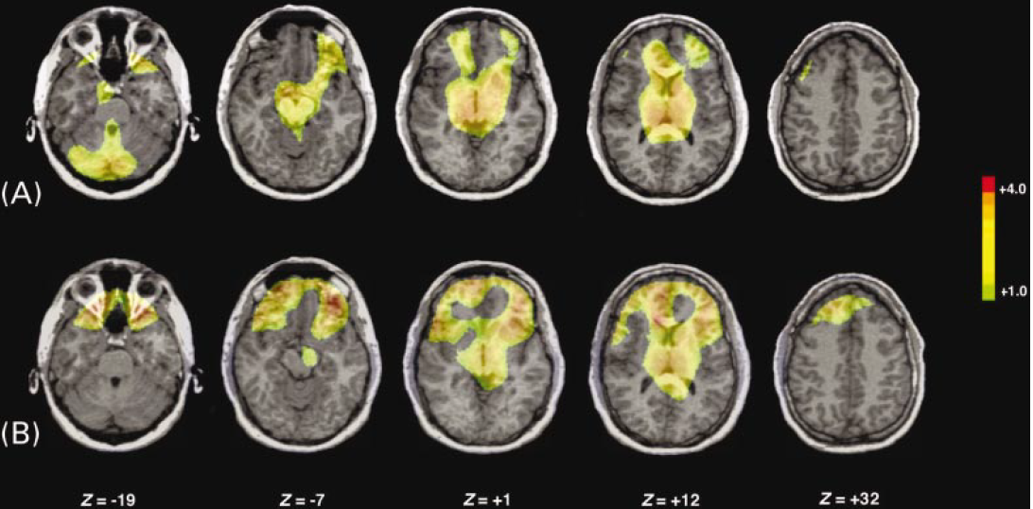
Sleep inertia after awekening (process W)
5 mn after awakening
20 mn after awakening
The prefrontal cortex takes longer to come "on-line" following sleep than other areas of the brain,
Prefrontal cortex is involved in executive functions, inhibition processes, problem solving and divergent thinking

Slide 7
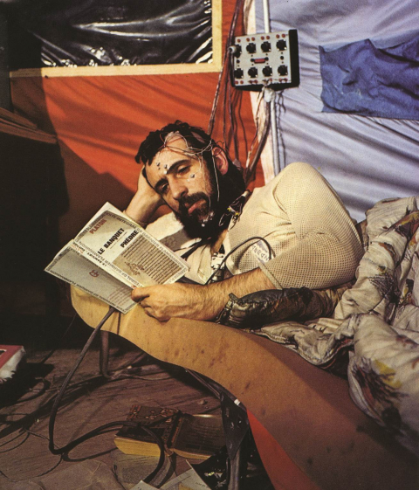
From science to rostering
0
12
24
12
24
12
24
Hours
Air Traffic Controllers work schedules
0
6
12
18
24
6
12
18
24
6
Hours
1
2
Rest
10
3
4
5
S
Day
6
Rest
Period = 25.3 h
7
8
Days
9
20
10
11
Rest
12
13
14
15
S
16
Rest
30
17
18
19
20
Wake
Max temperature max
Duties
Sleep
Mean temperature
Notes:
7
POINTERS :
Biological rhythms are endogenous, i.e. they are maintained in the absence of “time givers” (e.g. light-dark cycle, social contacts).
However, in this situation the period of the rhythm is longer than 24 hrs (around 26 to 27 hrs).

Slide 8
The primary and secondary sleep gates
Time to fall
asleep
High
Primary gate
Forbidden
Drowsiness
sleep
zone
Secondary gate
Low
0800
1600
2400
0800
Hours
(taken from Stampi, 1989)
Notes:
8
POINTERS :
The alertness is not stable over the 24 hours but shows significant variations with 2 sleep gates, a primary sleep gate during the night and a secondary in the early afternoon.
During these periods the sleep propensity and the drowsiness is maximum.
On the contrary, the late afternoon is called the forbidden zone for sleep as the sleep probability is the lowest.
The implication of this finding is that it is very difficult to advance its sleep pattern, for example in the night before an early morning departure.

Slide 9






Night sleep versus day sleep
Nightime sleep
Daytime sleep
Hours
Hours
23
0
1
2
3
4
5
6
8
9
10
11
12
Awake
Awake
REM
REM
Stage 1
Stage 1
Stage 2
Stage 2
Stage 3
Stage 3
Stage 4
Stage 4
REM sleep
Stage 1
Light sleep
Recovery
Stage 2
Fatigue
Stage 3
Deep sleep
Stage 4
Notes:
PC: insister a l’oral

Slide 10
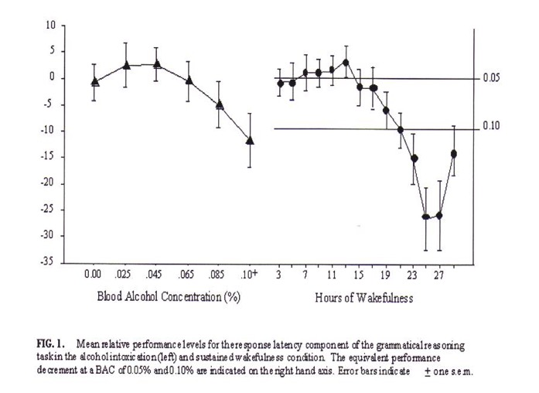
Equivalence between blood alcohol concentration and sleep deprivation
20 h of sleep deprivation= 0.08%
27h of sleep deprivation= 0.10%

Slide 11
Effects of a cumulative sleep deprivation
Actual Sleepiness/Fatigue
Self-Rated Sleepiness/Fatigue
4 hr sleep
6 hr sleep
8 hr sleep
Vigilance Lapses
Stanford Sleepiness Scale
Days of Sleep Restriction
Days of Sleep Restriction
Objective measures show fatigue progressively degrades cognitive performance
Self ratings of fatigue fail
to recognise all but
the initial fatigue effects!
BUT
11
Van Dongen, Maislin, Mullington, and Dinges (2003)

Slide 12
Fatigue management: a shared responsibility
FATIGUE
Management
Employee
Work related
Non-Work related
Hours of work
Lifestyle
Workload and
working conditions
Health

